Slide 1

Index of Deprivation 2019
Central Bedfordshire Council
Index of Deprivation 2019
Central Bedfordshire
Produced by
Population Health, Evidence & Intelligence
December 2019

Slide 2







Index of Deprivation 2019
Central Bedfordshire
Introduction
The Index of Multiple Deprivation (IMD) is the official measure of relative deprivation in England and is part of a series of outputs making up the English Indices of Deprivation (IoD). IoD 2019 was published in September, replacing the 2015 version. This briefing presents the headline findings from the 2019 publication.
The IoD brings together 39 indicators into seven distinct domains of deprivation covering income, employment, education, health, crime, housing and environment. These are grouped further into the Index of Multiple Deprivation. The IMD is an overall measure of multiple deprivation experienced by people living in an area and is calculated for every Lower-layer Super Output Area (LSOA), or neighbourhood, in England. All neighbourhoods in England are ranked according to their level of deprivation relative to other areas. Average IMD measures are available at local authority level.
Overall Deprivation
Central Bedfordshire ranks 137/151 upper tier and unitary local authorities (where 1 is most deprived) and 254/317 lower tier and unitary local authorities.3/157 LSOAs in CBC are ranked in the most deprived 20% nationally, with 0 among the most deprived 10%.
The most deprived areas are Dunstable-Manshead, Parkside and Flitwick.
Income
Amongst the top 10 and 20% most deprived, Central Bedfordshire has fallen from 1 to 0 and 10 to 8 respectively.
The most deprived are Leighton Buzzard North, Flitwick, Tithe Farm, Houghton Hall, Parkside and Dunstable-Manshead.
Employment
Rose amongst top 20% from 0 to 1 whilst the top 10% fell from 5 to 4.
The most deprived areas are Flitwick, Leighton Buzzard North, Houghton Hall, Parkside, Dunstable-Manshead.
Income deprivation affecting older people
No changes have occurred across the top 20 and 10% most deprived LSOAs with both staying at 2 and 0 respectively.
The most deprived wards are Sandy, Leighton Buzzard North, Tithe Farm, Parkside and Dunstable-Manshead.
Income deprivation affecting children
The most deprived LSOAs have increased from 8 to 9 LSOAs in the top 20, apart from the top 10 which stayed at 2.
The areas which are most deprived are Dunstable-Manshead, Dunstable-Northfields, Houghton Hall, Heath and Reach and Leighton Buzzard South.
Education Skills and Training
There has been a reduction across the top 20 and top 10 most deprived nationally from 16 to 15 and 8 to 6 respectively.
The areas which are most deprived are Flitwick, Leighton Buzzard North, Houghton Hall, Parkside and Dunstable-Manshead.
Children and Young People
There has been a decrease in the number of LSOAs in the top 20 and top 10% from 24 to 22 and 10 to 9 areas.
The areas which rank highest are Leighton Buzzard North, Flitwick, Tithe Farm, Parkside, Houghton Hall, Dunstable-Manshead.

Slide 3





Index of Deprivation 2019
Central Bedfordshire
Crime
Amongst the top 10 and 20% most deprived, the areas have fallen from 14 to 8 and from 22 to 19 apiece.
The wards that are the most deprived are Caddington, Leighton Buzzard South, Dunstable-Northfields, Dunstable-Icknield and Dunstable-Manshead.
Barriers to Housing and Services
Housing and service barriers have seen an increase in the areas which fall within the most deprived 10 and 20%. 11 and 21 areas are now in the top 10 and 20% most deprived from 8 and 18 in 2015.
The areas which are the most deprived are Caddington, Heath and Reach, Aspley and Woburn, Northill and Cranfield and Marston Moretaine.
Health Deprivation and Disability
There has been no changes in the number of LSOAs which rank in the top 20 and top 10% most deprived as both have remained at 1 and 0 areas respectively. T
The areas which are most deprived are Sandy, Flitwick, Leighton Buzzard North, Houghton Hall, Tithe Farm and Parkside.
Adult Skills
Adult skills deprivation has seen no change in the number of LSOAs that rank in the top 20 and top 10% most deprived areas, which remain at 10 and 0 respectively.
The areas which are the most deprived are Tithe Farm, Parkside, Houghton Hall, Dunstable-Manshead and Flitwick.
Living Environment
Living environment deprivation has seen an increase in the number of LSOAs that fall within the most deprived 10 and 20% from 0 to 1 and 1 to 4 respectively.
The most deprived areas in Central Bedfordshire are Houghton Conquest and Haynes, Cranfield and Marston Moretaine, Aspley and Woburn, Northill, Dunstable-Icknield, Manshead and Northfield.
Figure 1: Change in the number of LSOAs which rank in the top 20 and top 10% from 2015 to 2019
Domain | Top 20% most deprived nationally |  |  | Top 10% most deprived nationally
 | 2015 | 2019 | Change | 2015 | 2019 | Change
Income | 10 | 8 | -2 | 1 | 0 | -1
IDACI | 8 | 9 | +1 | 2 | 2 | 0
IDAOPI | 2 | 2 | 0 | 0 | 0 | 0
Employment | 5 | 4 | -1 | 0 | 1 | +1
Education Skills and Training | 16 | 15 | -1 | 8 | 6 | -2
Children and Young People | 24 | 22 | -2 | 10 | 9 | -1
Adult Skills | 10 | 10 | 0 | 0 | 0 | 0
Health Deprivation & Disability | 1 | 1 | 0 | 0 | 0 | 0
Crime | 22 | 19 | 3 | 14 | 8 | -6
Barriers to Housing and Services | 18 | 21 | +3 | 8 | 11 | +3
Living Environment | 1 | 4 | +3 | 0 | 1 | +1

Slide 4
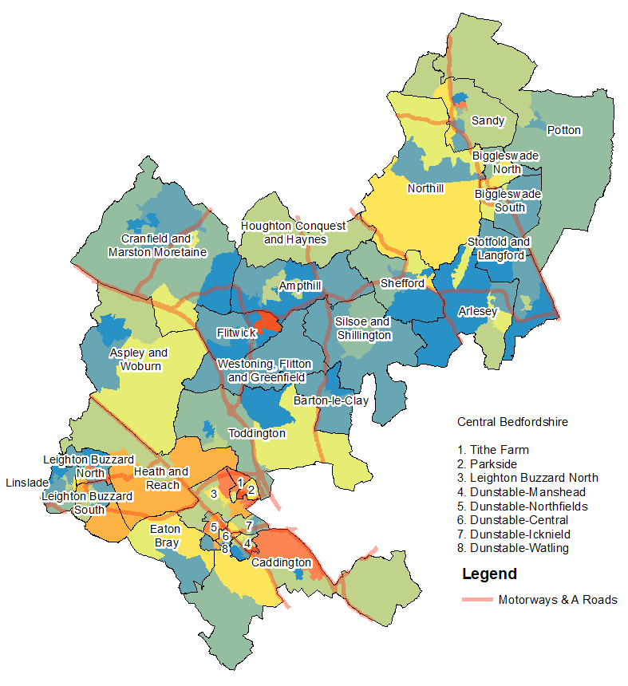
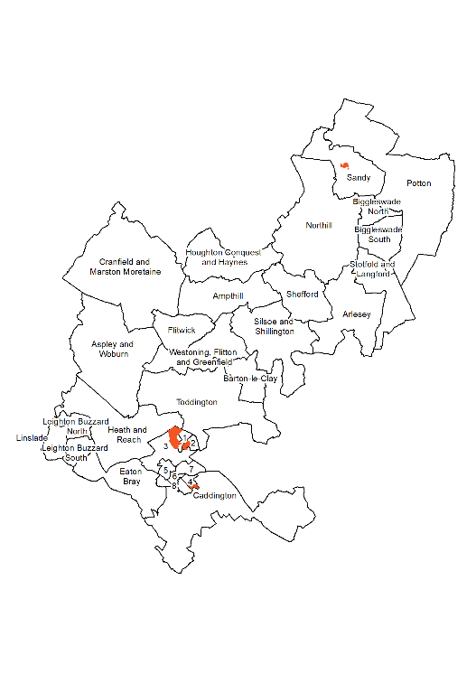
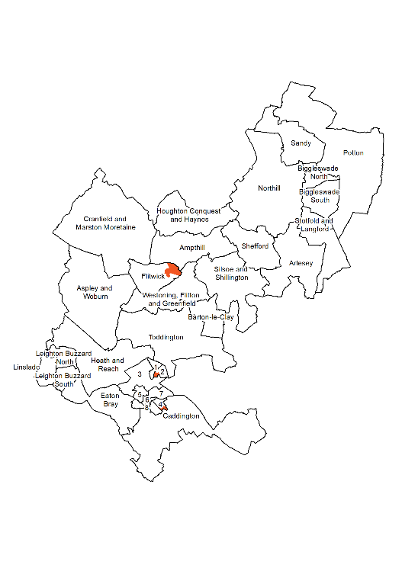
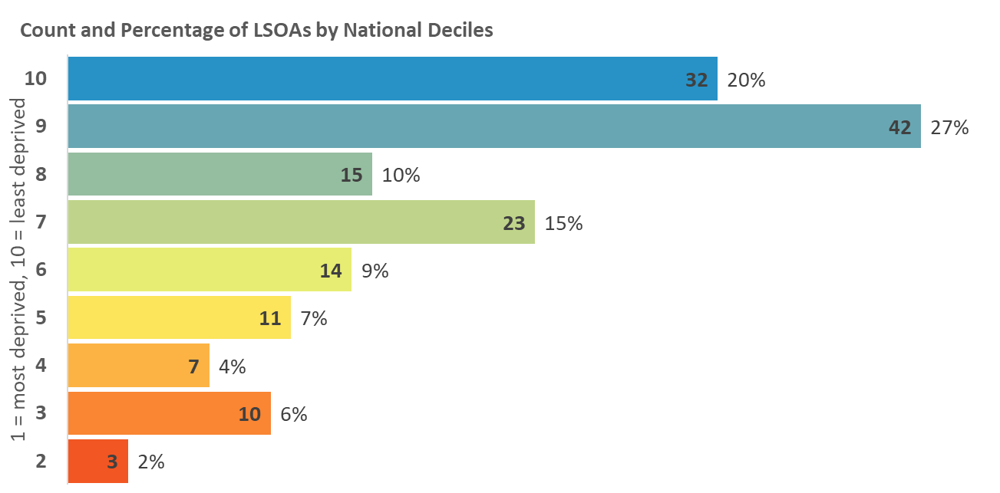
Index of Deprivation 2019
Central Bedfordshire
Index of Multiple Deprivation
The overall Index of Multiple Deprivation (IMD) is a weighted measure based on information
relating to income, employment, education, health, crime, housing, and environment.
Map 1: Distribution of the Index of Multiple Deprivation 2019
Areas amongst the most deprived 10% and 20% in England
2015
2019
Legend
10% most deprived
20% most deprived
Tithe Farm
Parkside
Houghton Hall
Dunstable – Manshead
Dunstable-Northfields
Dunstable-Central
Dunstable-Icknield
Dunstable-Watling

Slide 5
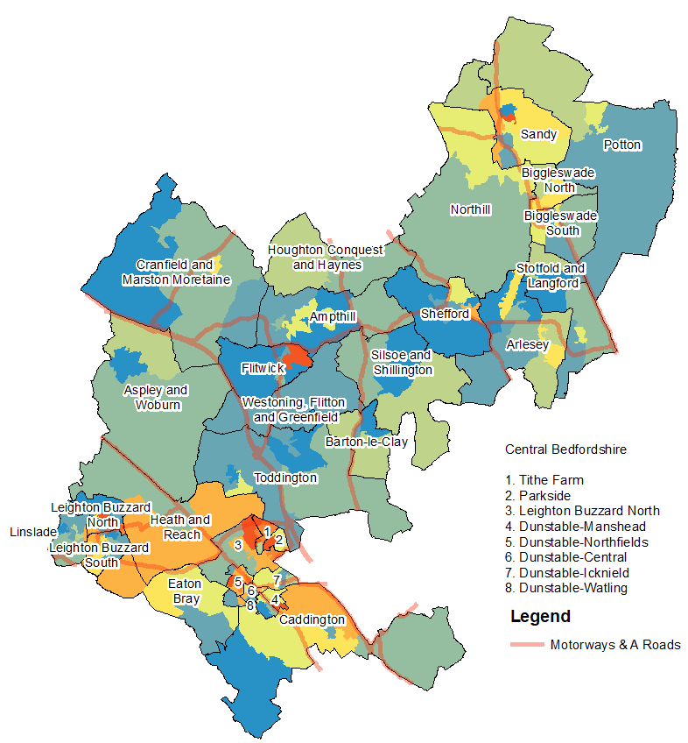
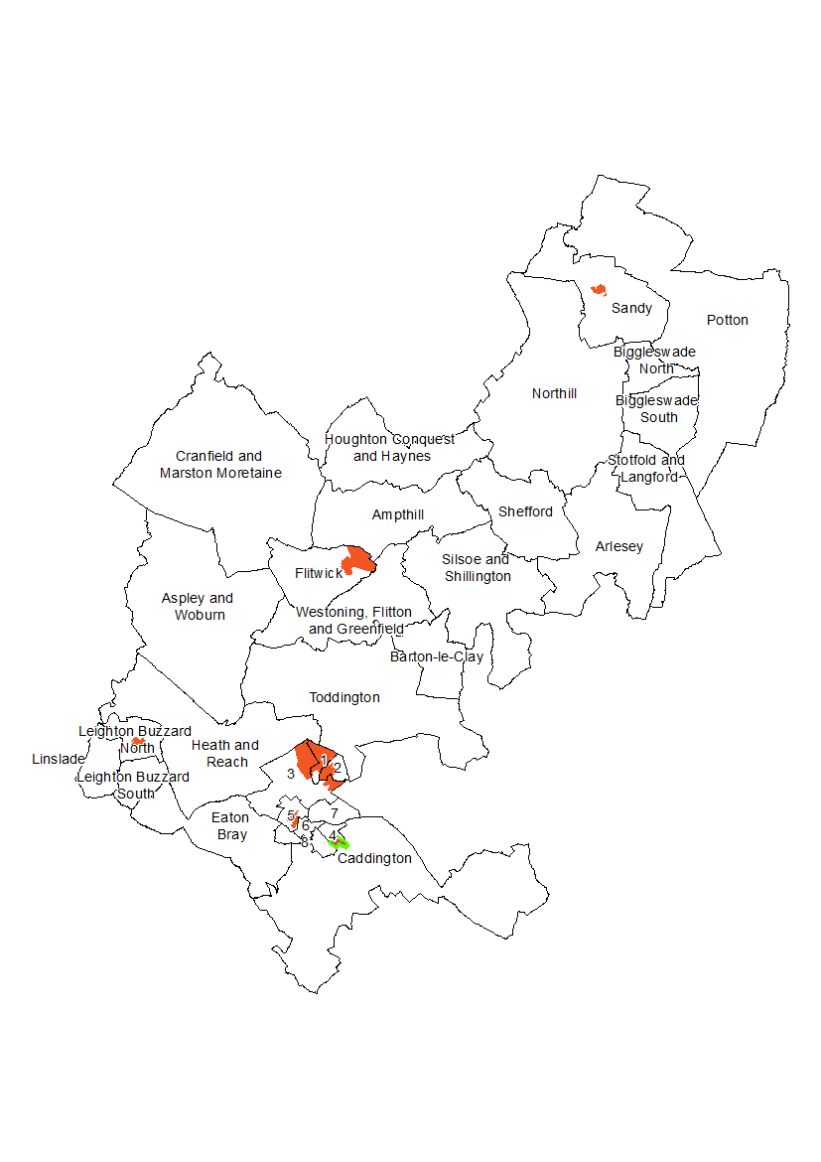
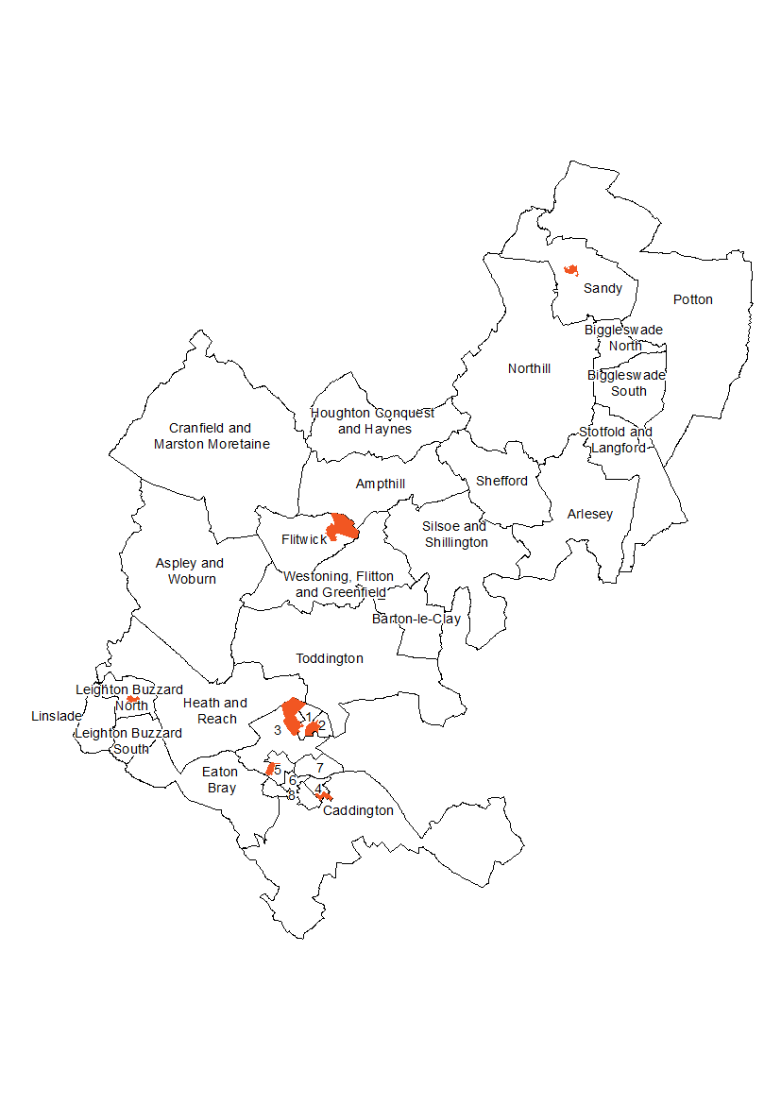
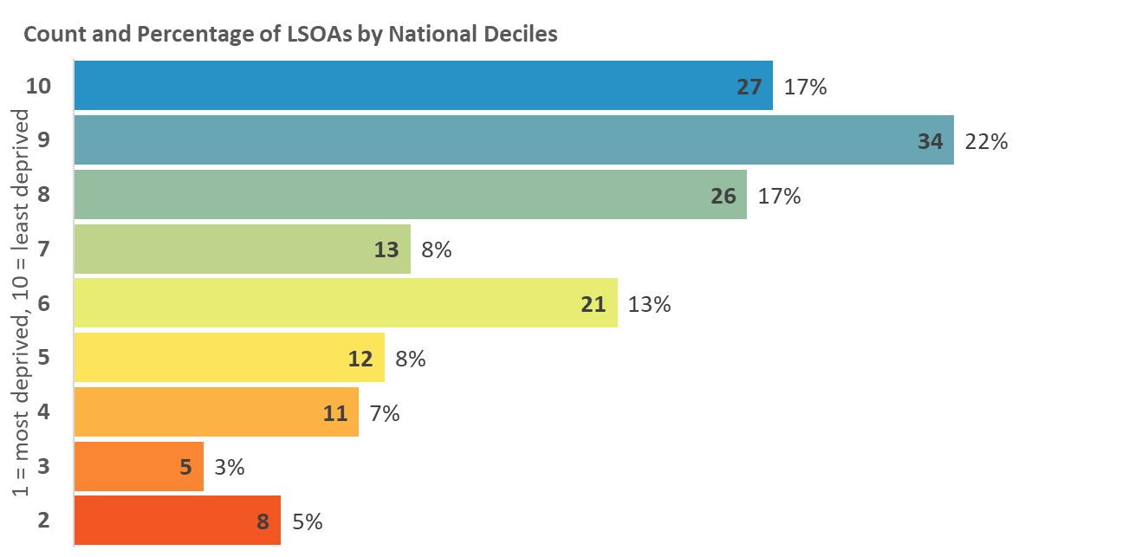
Index of Deprivation 2019
Central Bedfordshire
Income Deprivation
The proportion of the population in an area experiencing deprivation relating to low income. Low income includes both those people that are out-of-work, and those in work but have low earnings.
Map 2: Distribution of Income Deprivation 2019
Areas amongst the most deprived 10% and 20% in England
2015
2019
Tithe Farm
Parkside
Houghton Hall
Dunstable – Manshead
Dunstable-Northfields
Dunstable-Central
Dunstable-Icknield
Dunstable-Watling
Legend
10% most deprived
20% most deprived

Slide 6
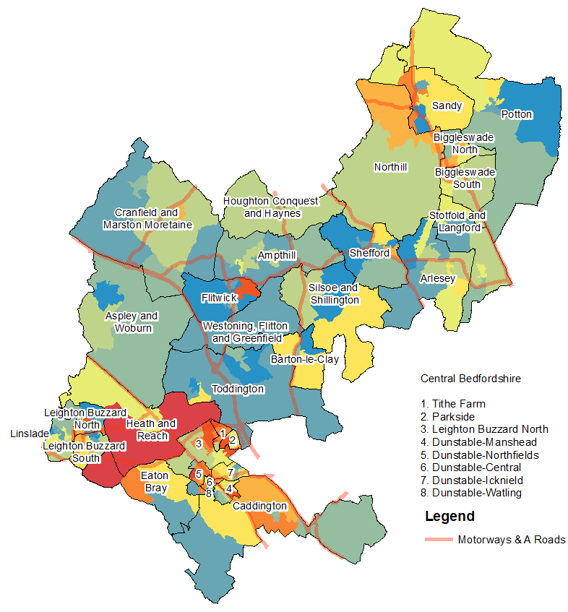
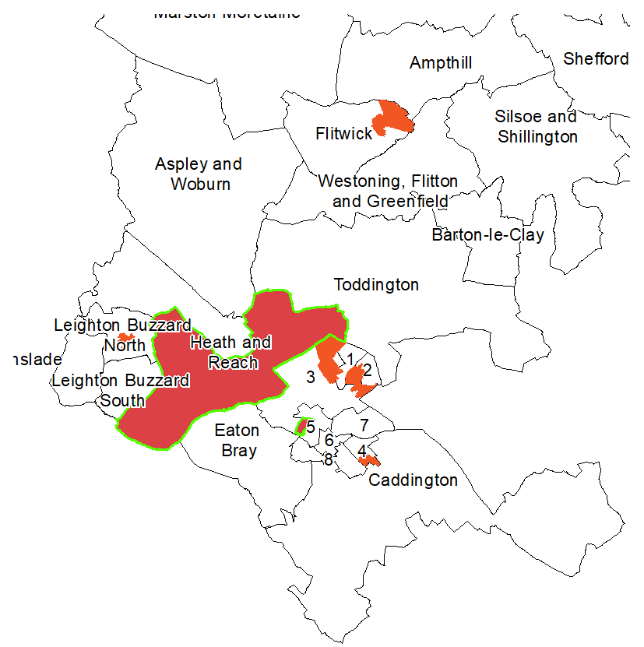
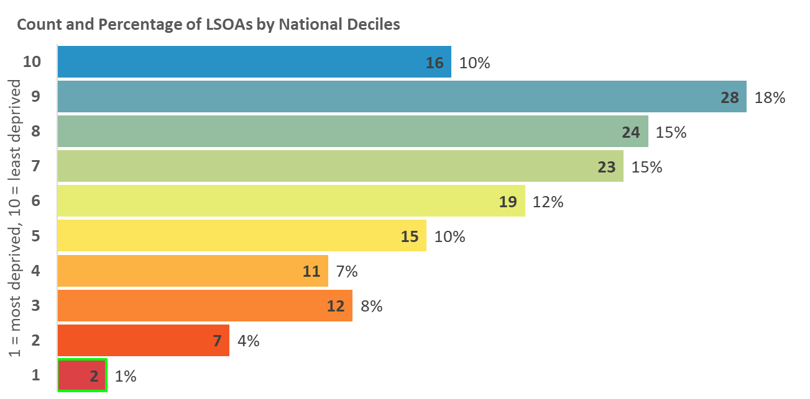
Index of Deprivation 2019
Central Bedfordshire
Income Deprivation Affecting
Children Index (IDACI)
A subset of the Income Deprivation Domain. The proportion of children (0-15) in each LSOA that live in families that are income deprived; those that are in receipt of Income Support, income-based Jobseeker’s Allowance, Pension Credit Guarantee or Working/Child Tax Credit below a given threshold.
Map 3: Distribution of IDACI 2019
Areas amongst the most deprived 10% and 20% in England
2015
2019
Legend
10% most deprived
20% most deprived
Tithe Farm
Parkside
Houghton Hall
Dunstable – Manshead
Dunstable-Northfields
Dunstable-Central
Dunstable-Icknield
Dunstable-Watling

Slide 7
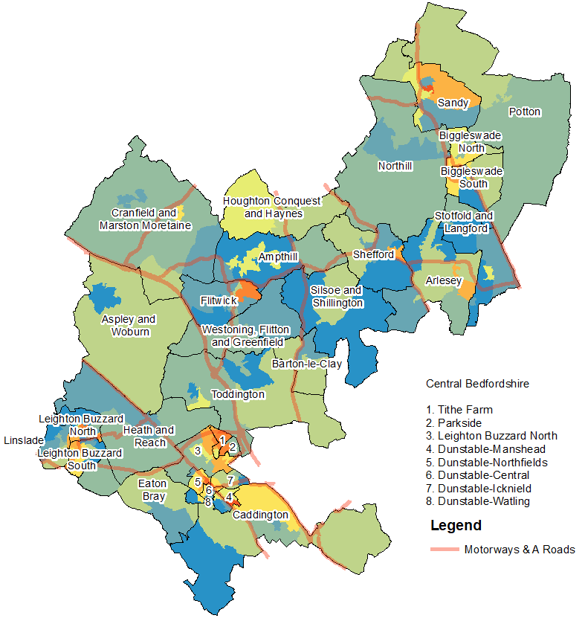
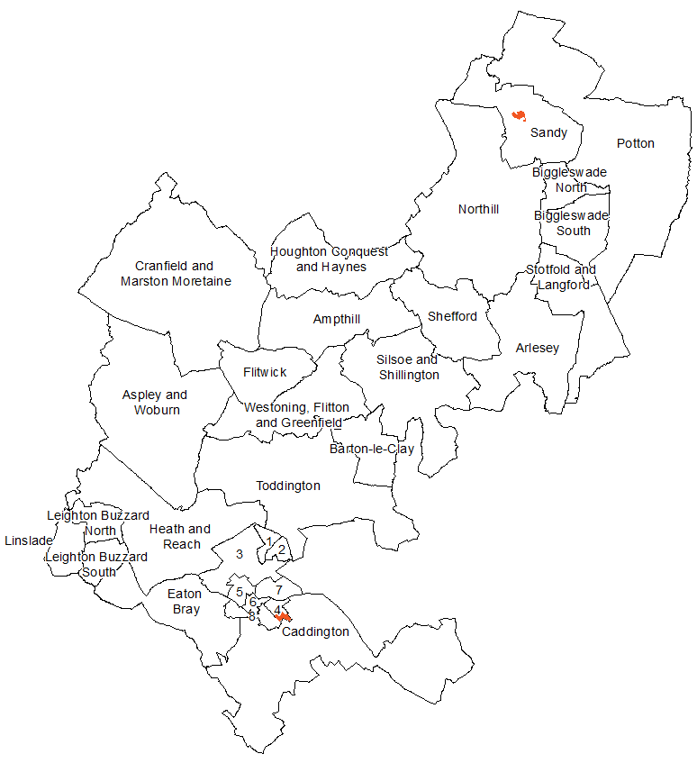
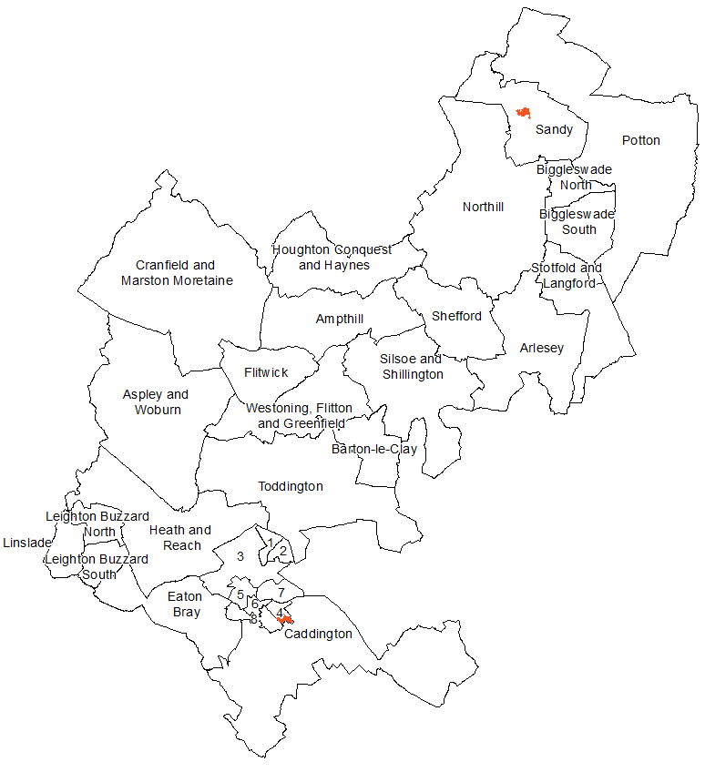
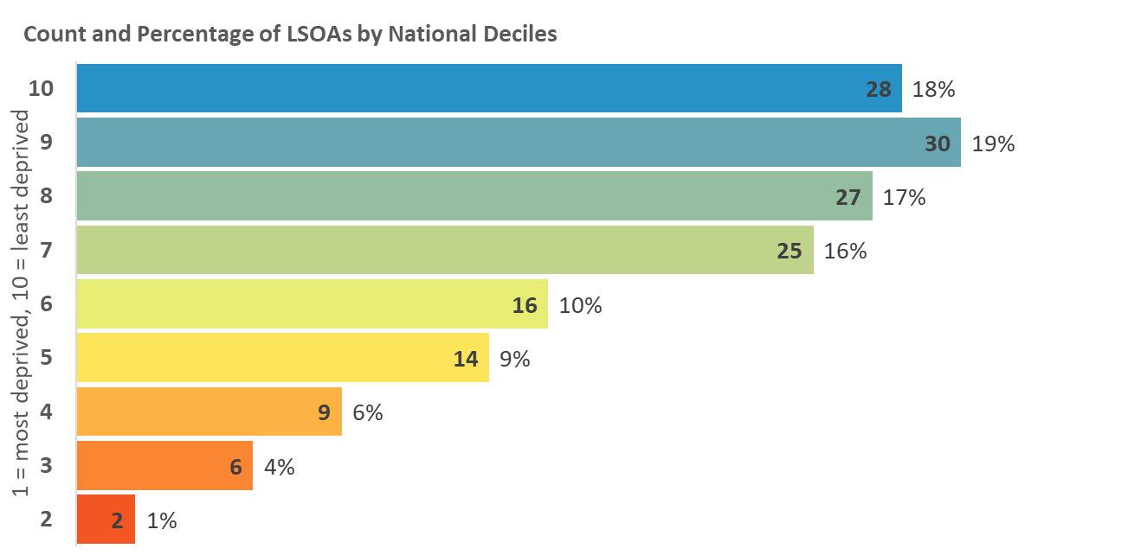
Index of Deprivation 2019
Central Bedfordshire
Income Deprivation Affecting
Older People (IDAOPI)
A subset of the Income Deprivation Domain. The proportion of a LSOAs population aged 60 and over receiving Income Support, income-based Jobseekers Allowance, income-based Employment and Support Allowance, or Pension Credit (Guarantee).
Map 4: Distribution of IDAOPI 2019
Areas amongst the most deprived 10% and 20% in England
2015
2019
Tithe Farm
Parkside
Houghton Hall
Dunstable – Manshead
Dunstable-Northfields
Dunstable-Central
Dunstable-Icknield
Dunstable-Watling
Legend
10% most deprived
20% most deprived

Slide 8
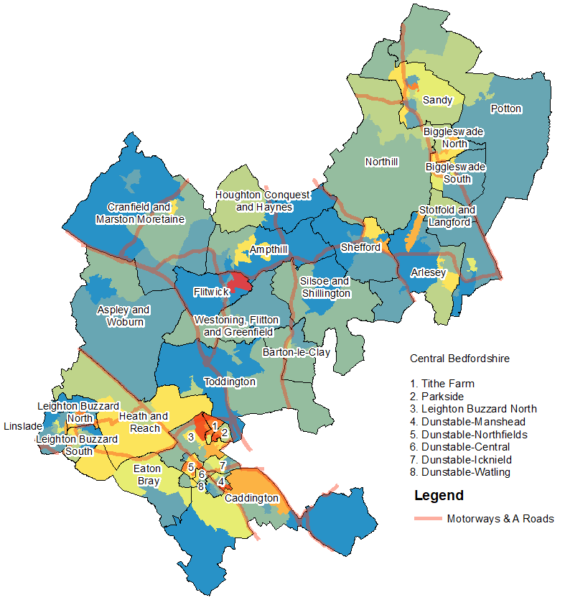
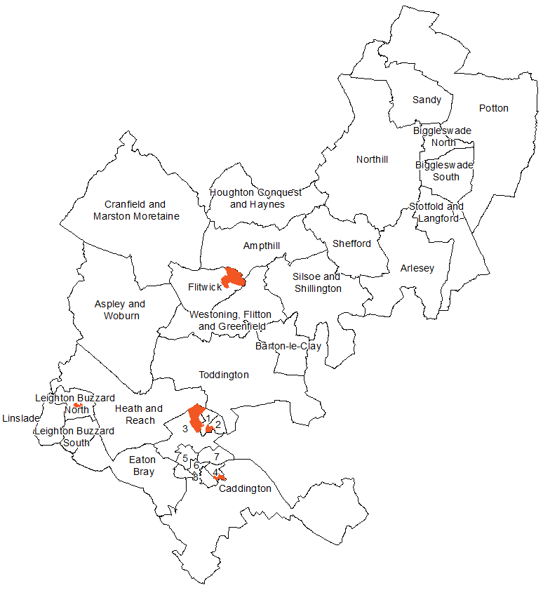
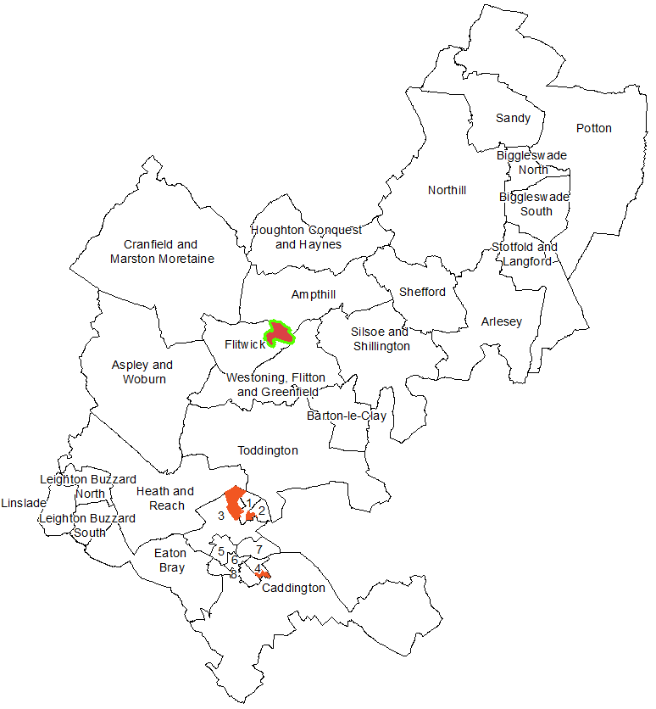
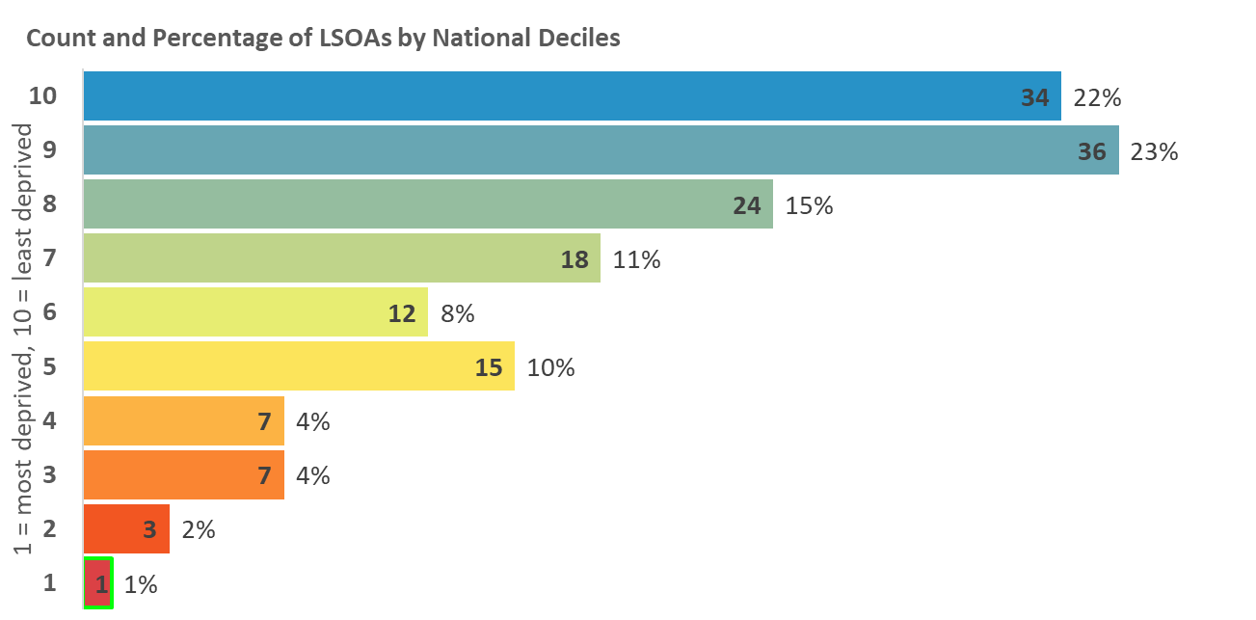
Index of Deprivation 2019
Central Bedfordshire
Employment Deprivation
The proportion of the working age population involuntarily excluded from the labour market. Indicators included are claimants of Jobseekers’ Allowance, Employment and Support Allowance, Incapacity Benefit, Severe Disablement Allowance, and Carer’s Allowance.
Map 5: Distribution of Employment Deprivation 2019
Areas amongst the most deprived 10% and 20% in England
2015
2019
Tithe Farm
Parkside
Houghton Hall
Dunstable – Manshead
Dunstable-Northfields
Dunstable-Central
Dunstable-Icknield
Dunstable-Watling
Legend
10% most deprived
20% most deprived

Slide 9
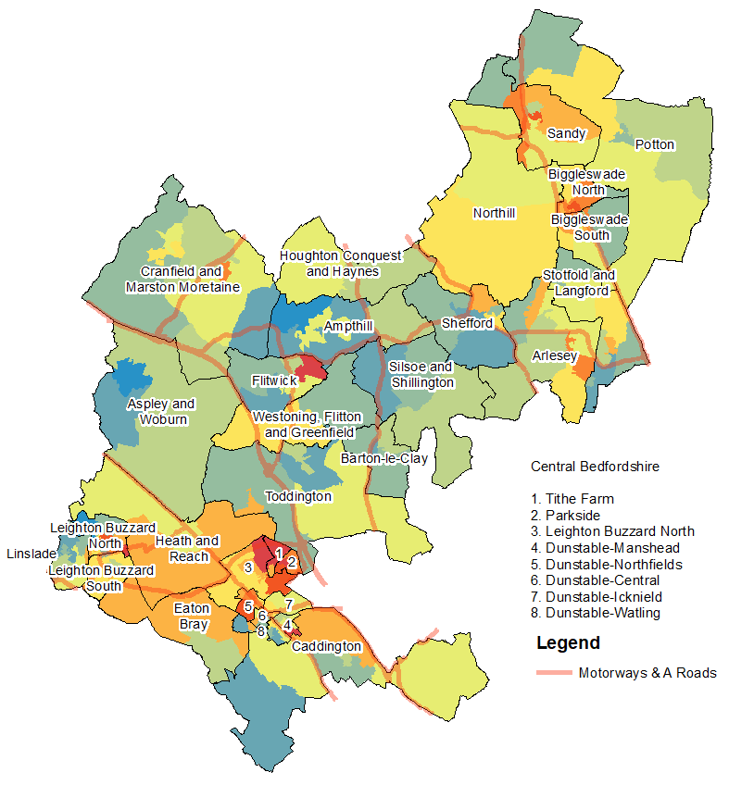
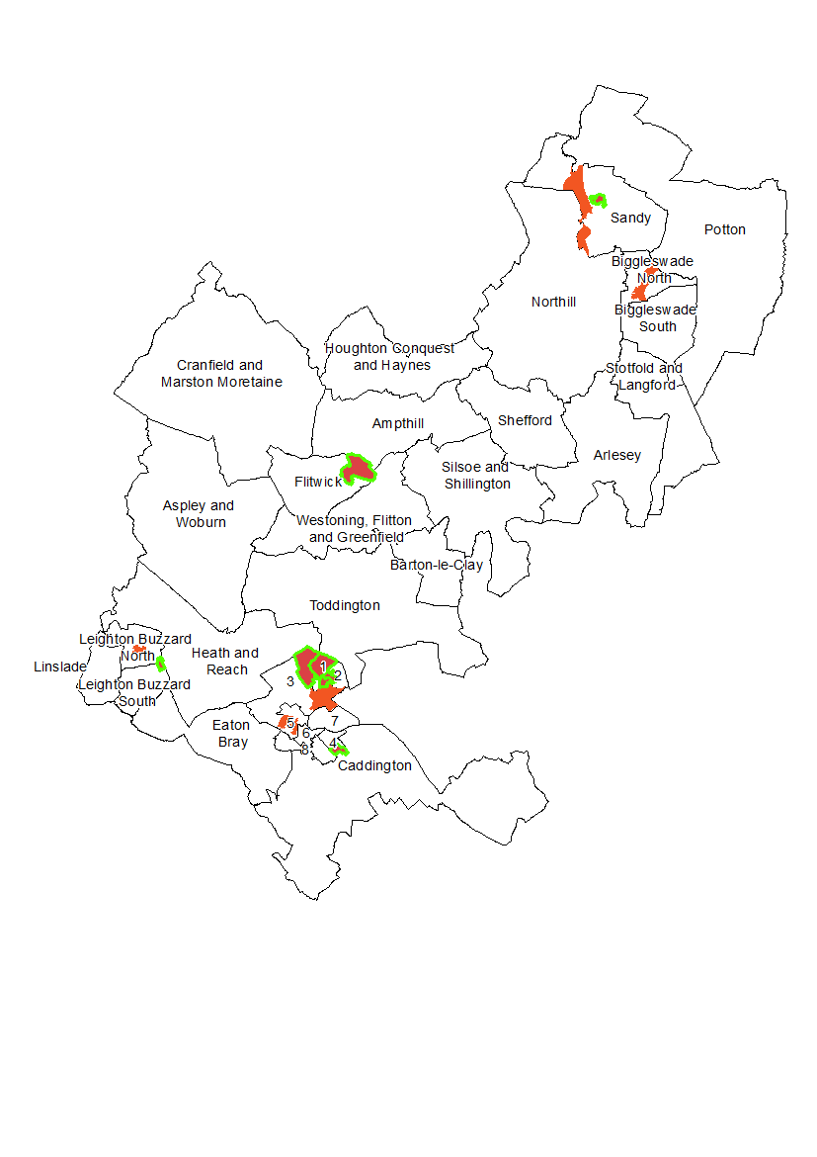
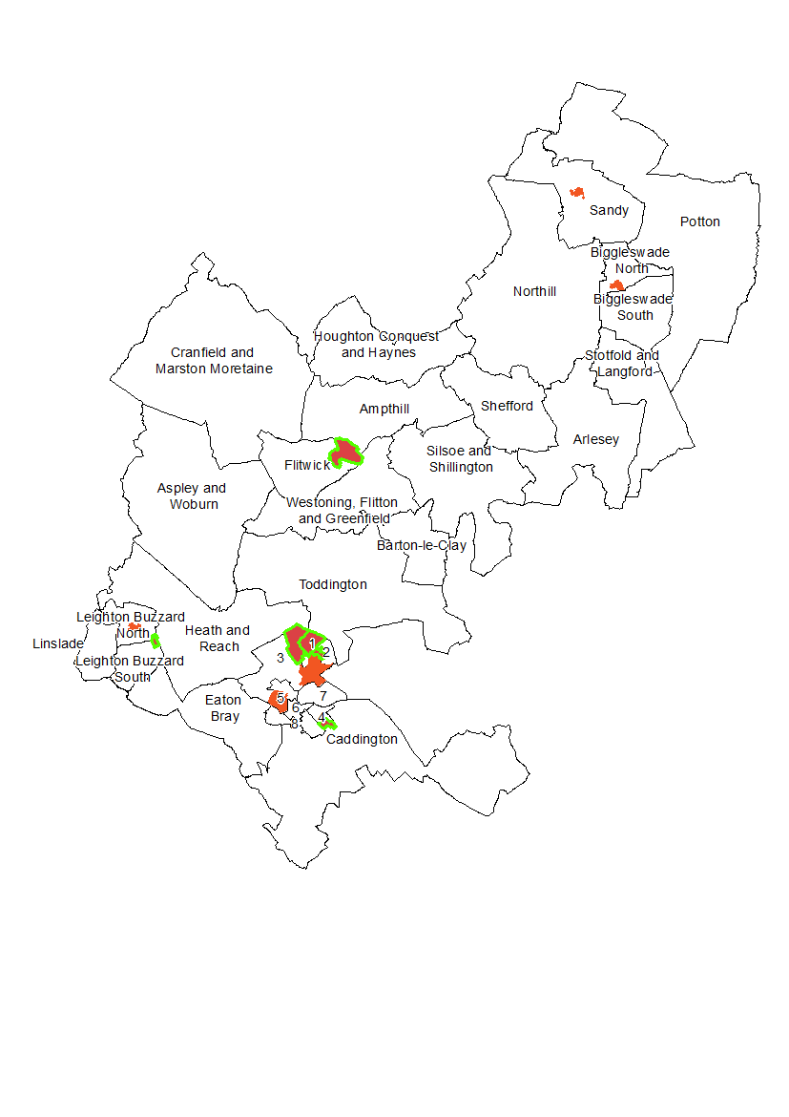
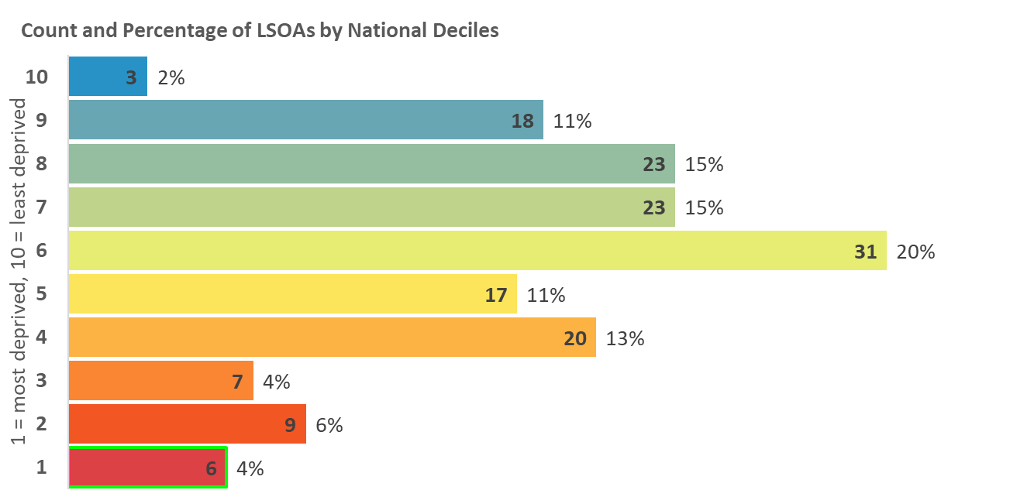
Index of Deprivation 2019
Central Bedfordshire
Education, Skills and Training
Deprivation
Measures the lack of attainment and skills in the local population. The indicator is related to two sub-domains: children and young people as well as adult skills. These two sub-domains reflect the ‘flow’ and ‘stock’ of educational disadvantage within an area respectively.
Map 6: Distribution of Education, Skills and Training
Deprivation 2019
Areas amongst the most deprived 10% and 20% in England
2015
2019
Tithe Farm
Parkside
Houghton Hall
Dunstable – Manshead
Dunstable-Northfields
Dunstable-Central
Dunstable-Icknield
Dunstable-Watling
Legend
10% most deprived
20% most deprived

Slide 10
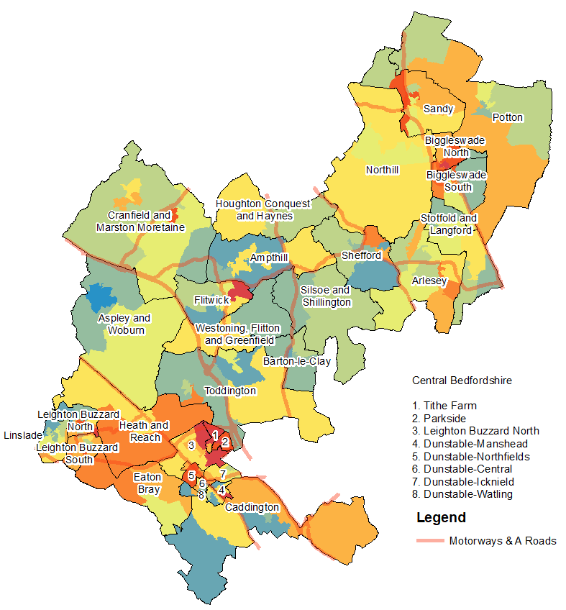
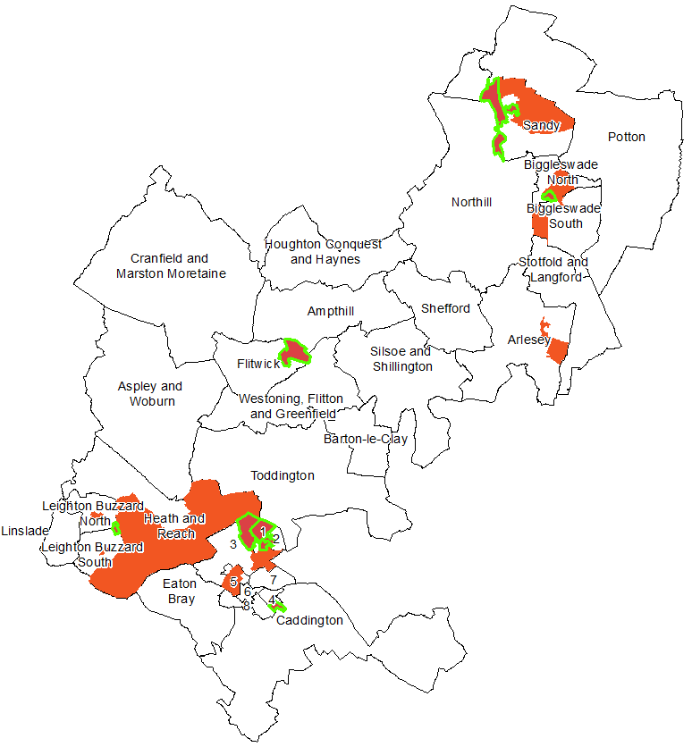
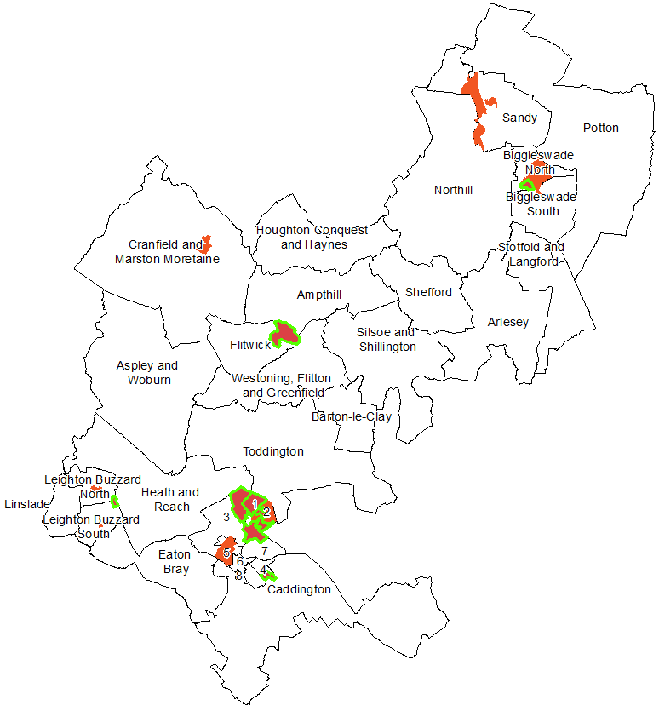
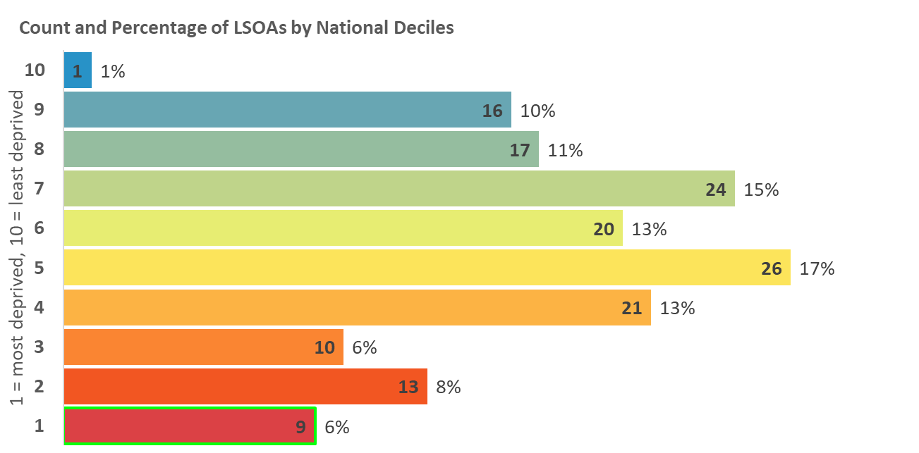
Index of Deprivation 2019
Central Bedfordshire
Children and Young People
Deprivation
Measure based on average points score for Key Stage 2 and 4 attainment, proportion of secondary school (authorised and unauthorised) absences, proportion of young people not staying on in education above age 16, and young people aged 21 not entering higher education.
Map 7: Distribution of Children and Young People
Deprivation 2019
Areas amongst the most deprived 10% and 20% in England
2015
2019
Legend
10% most deprived
20% most deprived
Tithe Farm
Parkside
Houghton Hall
Dunstable – Manshead
Dunstable-Northfields
Dunstable-Central
Dunstable-Icknield
Dunstable-Watling

Slide 11
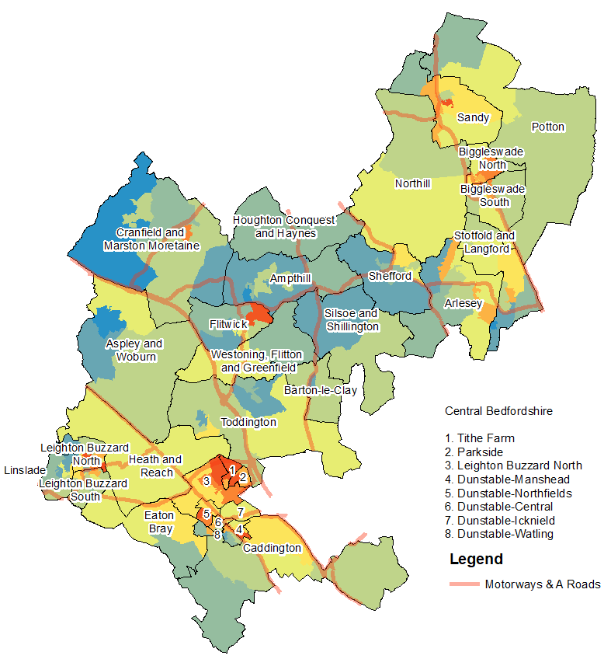
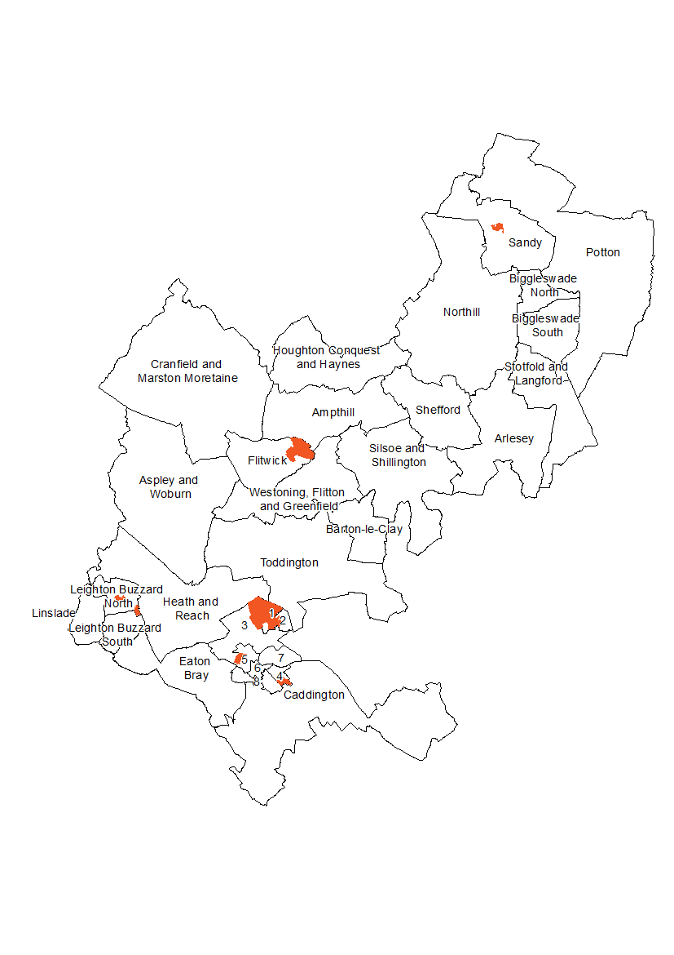
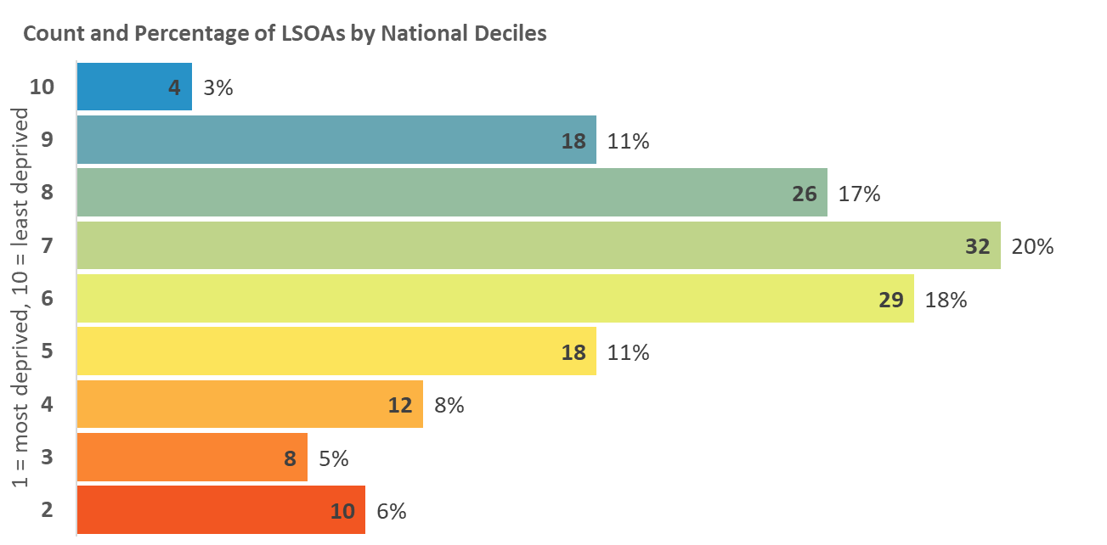
Index of Deprivation 2019
Central Bedfordshire
Adult Skills Deprivation
Based on two indicators: Adult skills and English language proficiency. Adult skills is the proportion of working age adults with no or low qualifications. English language proficiency is the proportion of working age adults who cannot speak English or cannot speak English well.
Map 8: Distribution of Adult Skills Deprivation 2019
Areas amongst the most deprived 10% and 20% in England
2015
2019
Tithe Farm
Parkside
Houghton Hall
Dunstable – Manshead
Dunstable-Northfields
Dunstable-Central
Dunstable-Icknield
Dunstable-Watling
Legend
10% most deprived
20% most deprived

Slide 12
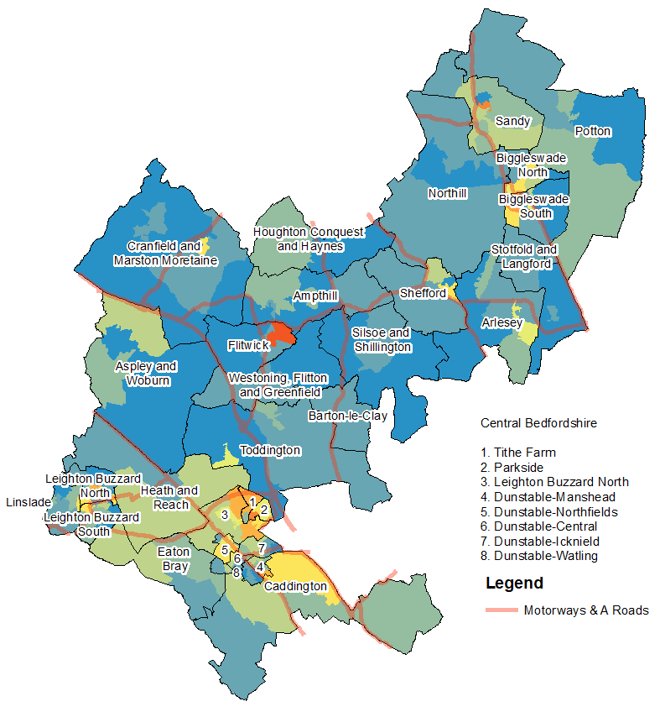
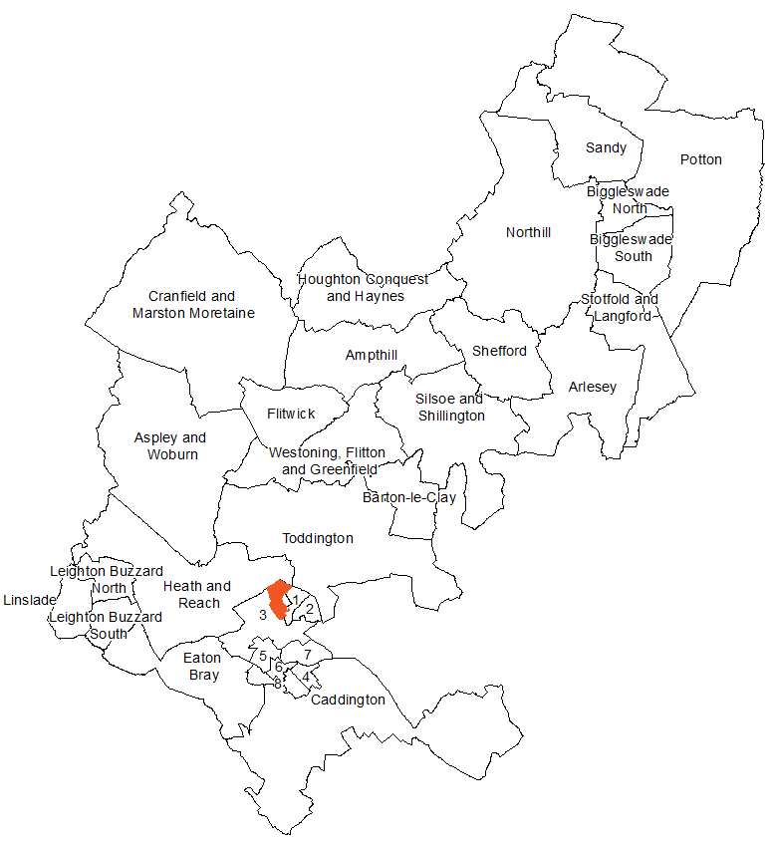
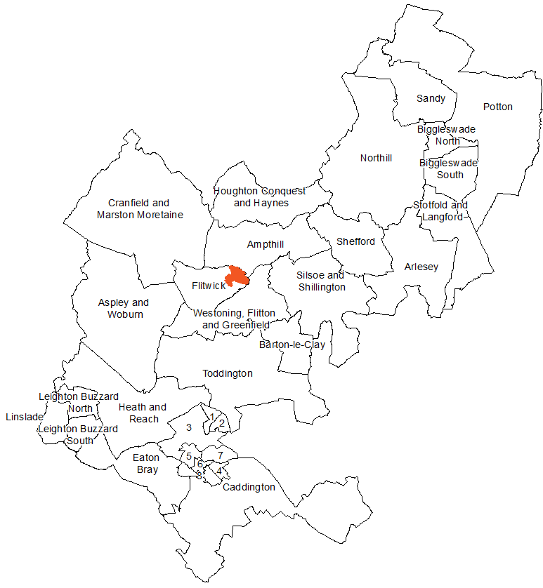
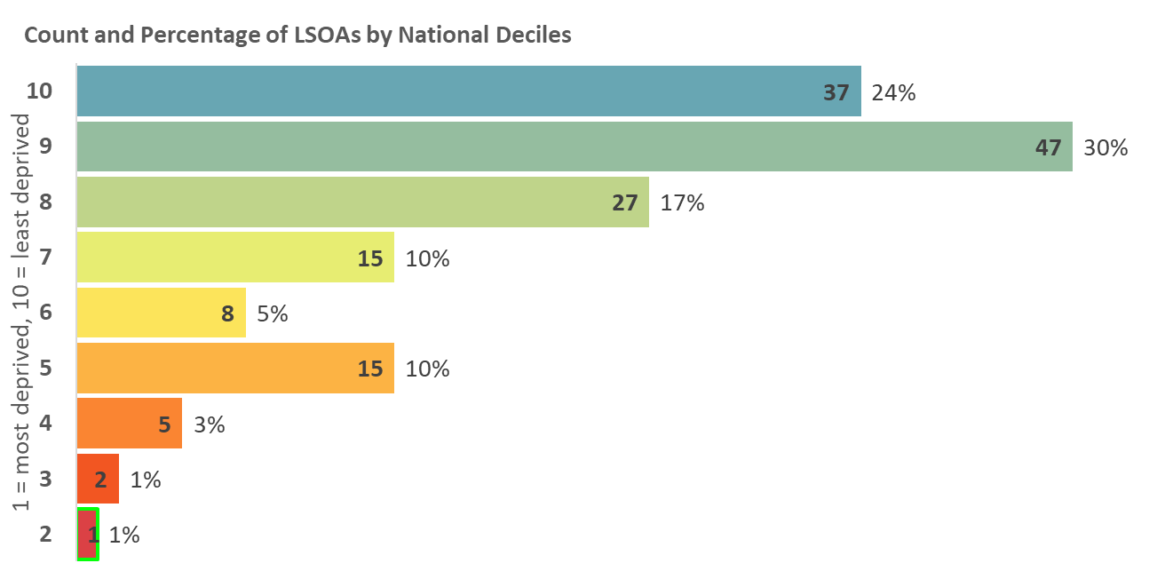
Index of Deprivation 2019
Central Bedfordshire
Health Deprivation and Disability
Deprivation
Measures the risk of premature death and the impairment of quality of life through poor physical or mental health. The domain measures morbidity, disability and premature mortality but not aspects of behaviour or environment that may be predictive of future health deprivation.
Map 9: Distribution of Health and Disability Deprivation 2019
Areas amongst the most deprived 10% and 20% in England
2015
2019
Tithe Farm
Parkside
Houghton Hall
Dunstable – Manshead
Dunstable-Northfields
Dunstable-Central
Dunstable-Icknield
Dunstable-Watling
Legend
10% most deprived
20% most deprived

Slide 13
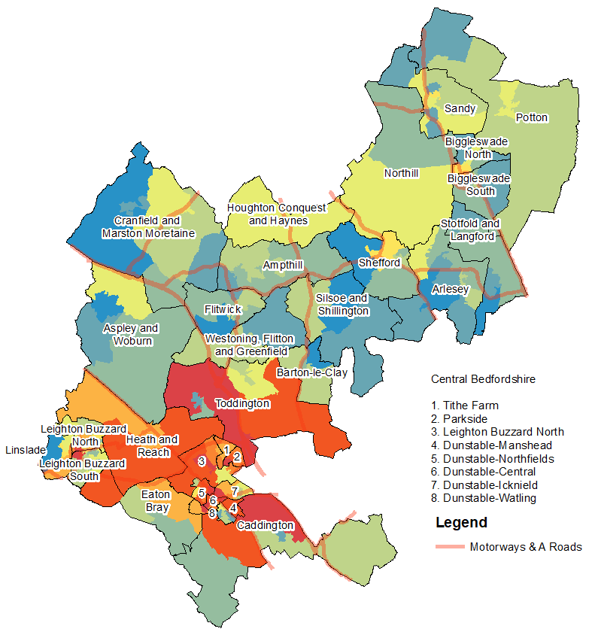
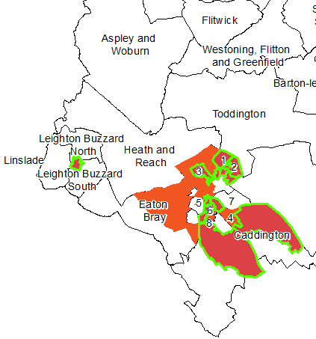
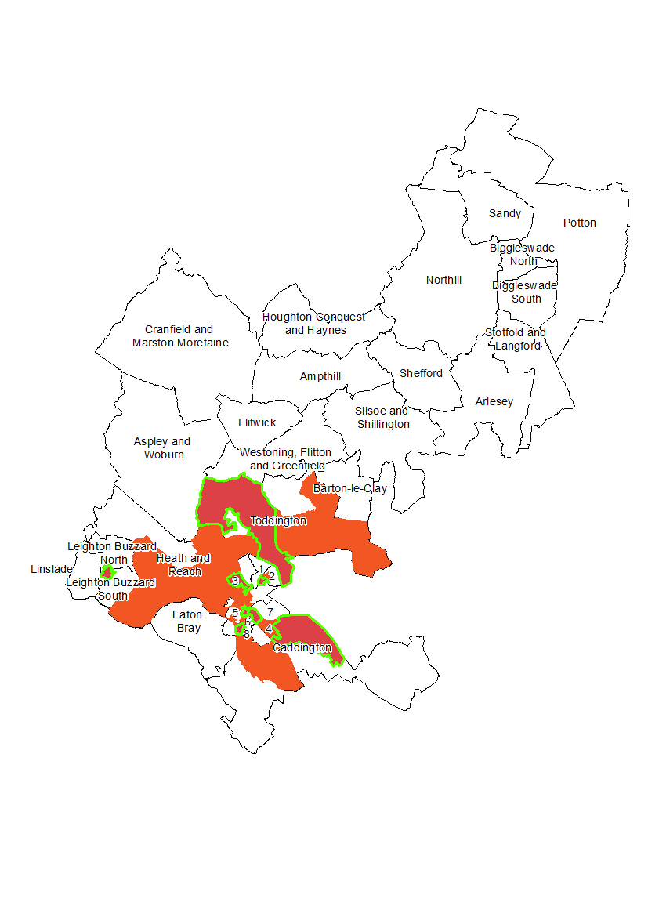
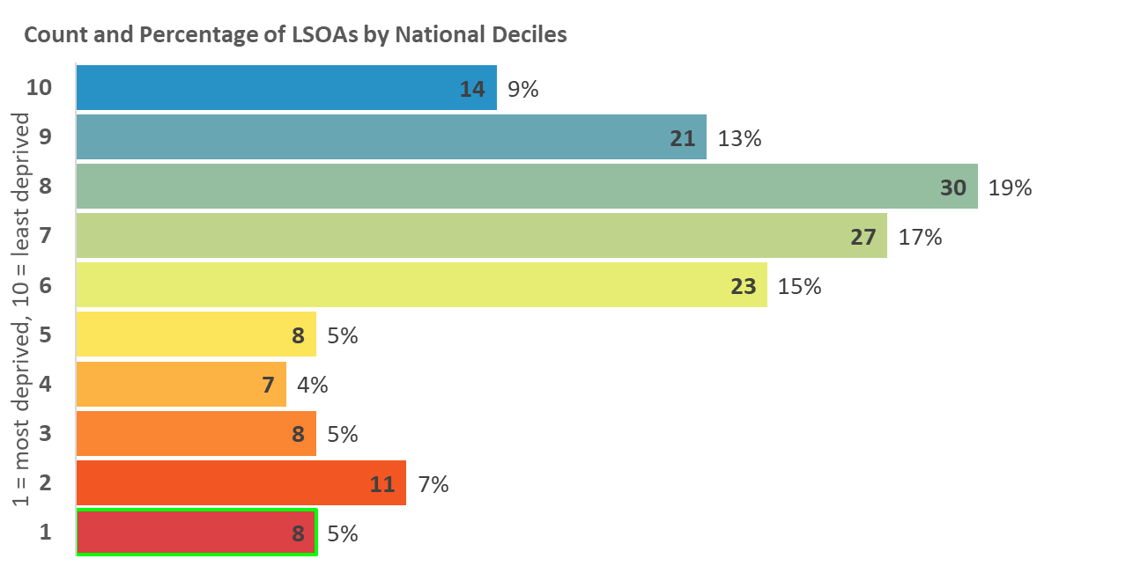
Index of Deprivation 2019
Central Bedfordshire
Crime Deprivation
Measures the risk of personal and material victimisation at local level. Based on the numbers of reported crime types relating to violence, burglary, theft, and criminal damage.
Map 10: Distribution of Crime Deprivation 2019
Areas amongst the most deprived 10% and 20% in England
2015
2019
Tithe Farm
Parkside
Houghton Hall
Dunstable – Manshead
Dunstable-Northfields
Dunstable-Central
Dunstable-Icknield
Dunstable-Watling
Legend
10% most deprived
20% most deprived

Slide 14
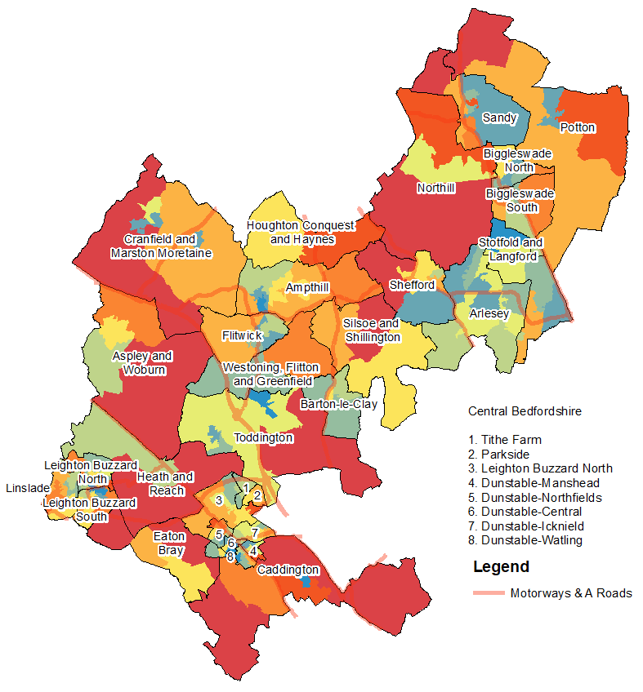
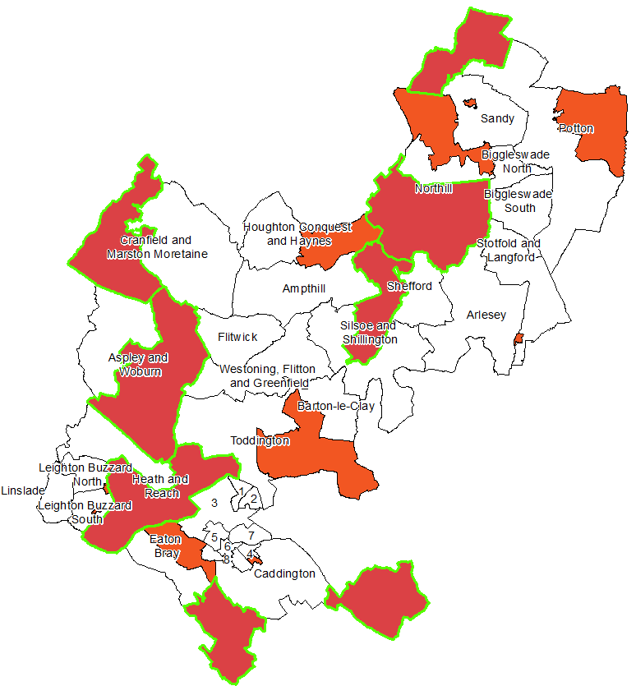
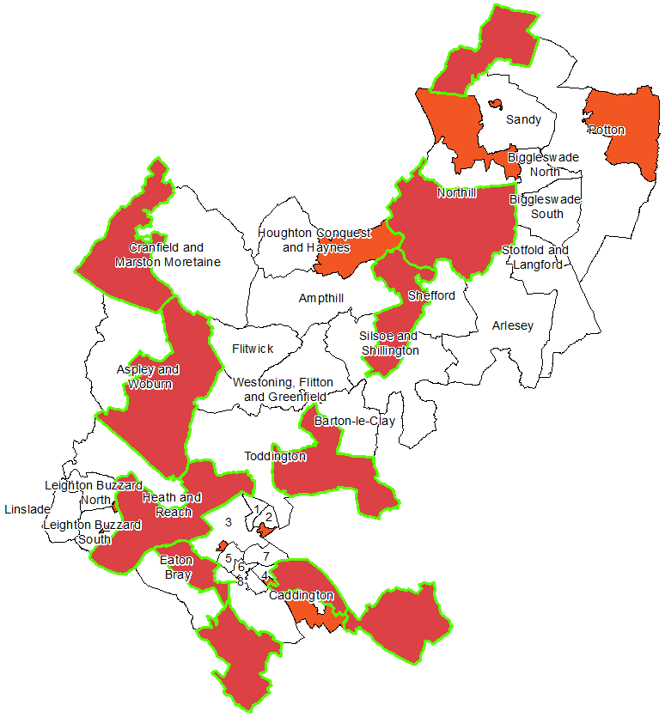
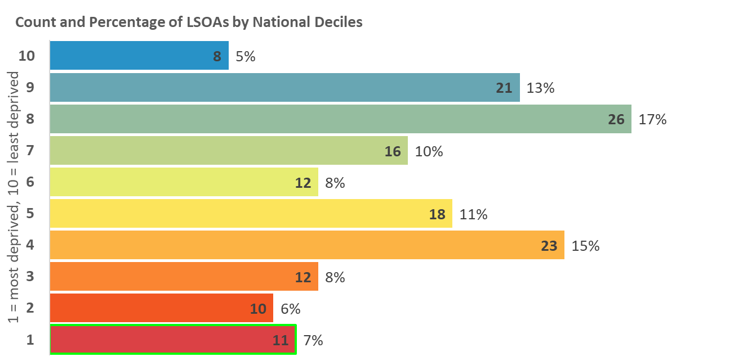
Index of Deprivation 2019
Central Bedfordshire
Barriers to Housing and
Services Deprivation
Measures the physical and financial accessibility of housing and key local services. The indicators falls into two sub-domains: ‘geographical barriers’, which relate to the physical proximity of local services, and ‘wider barriers’ which includes issues relating to access to housing i.e. affordability.
Map 11: Distribution of Barriers to Housing and Services
Deprivation 2019
Areas amongst the most deprived 10% and 20% in England
2015
2019
Legend
10% most deprived
20% most deprived
Tithe Farm
Parkside
Houghton Hall
Dunstable – Manshead
Dunstable-Northfields
Dunstable-Central
Dunstable-Icknield
Dunstable-Watling

Slide 15
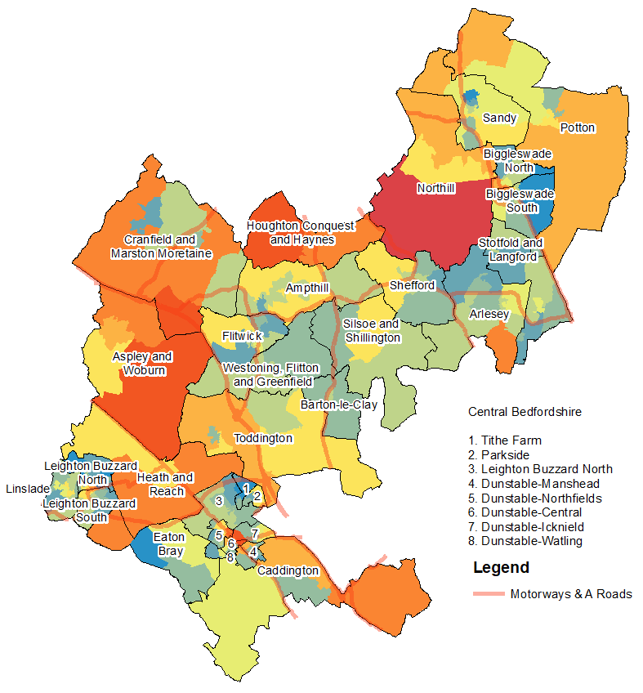
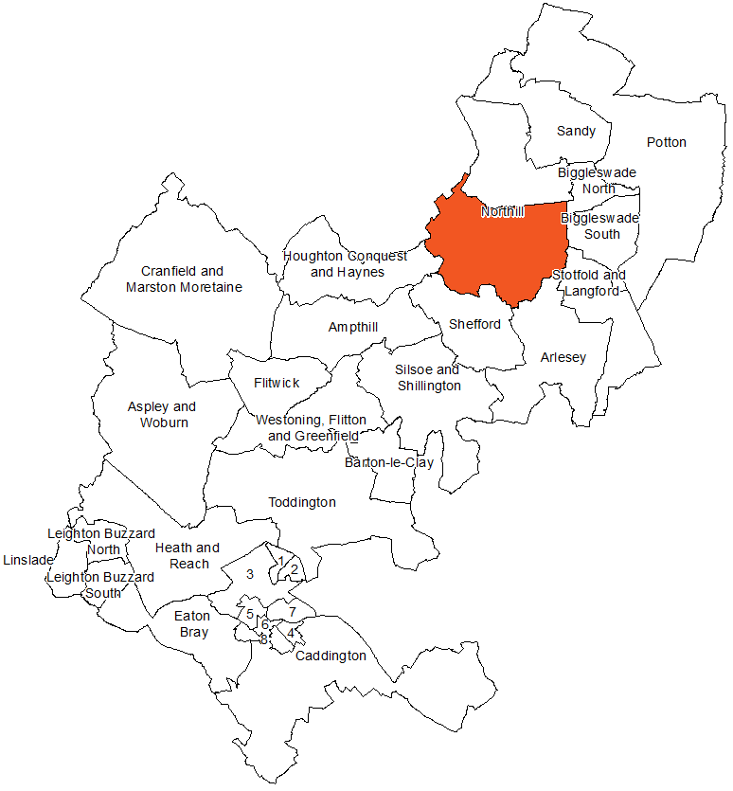
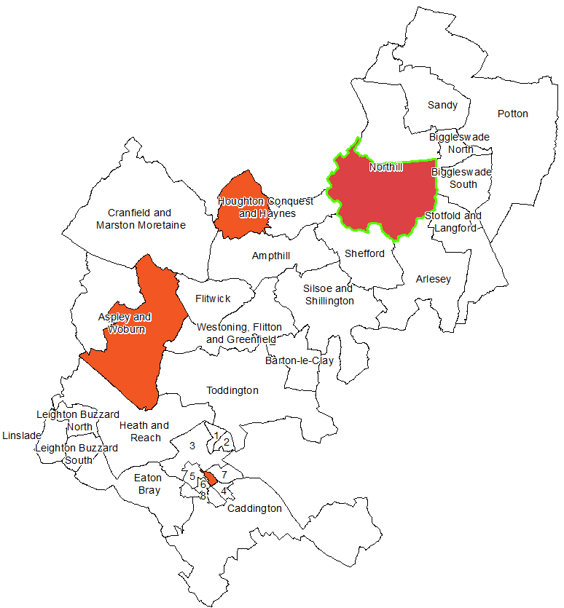
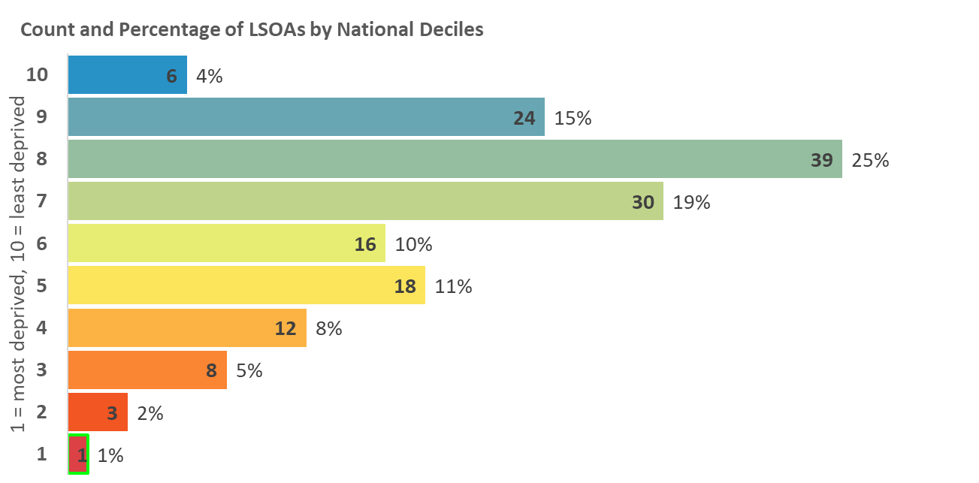
Index of Deprivation 2019
Central Bedfordshire
Living Environment
Deprivation
Measures the quality of the local environment. The indicator falls into two sub-domains. The ‘indoors’ living environment measures the quality of housing; while the ‘outdoors’ living environment contains measures of air quality and road traffic accidents.
Map 12: Distribution of Living Environment Deprivation 2019
Areas amongst the most deprived 10% and 20% in England
2015
2019
Tithe Farm
Parkside
Houghton Hall
Dunstable – Manshead
Dunstable-Northfields
Dunstable-Central
Dunstable-Icknield
Dunstable-Watling
Legend
10% most deprived
20% most deprived

Slide 16
Index of Deprivation 2019
Central Bedfordshire
Figure 2: The wards which contain the top 5 most deprived LSOAs by each IoD subdomain
Ward | Overall | Income | Employment | Income deprivation affecting older people | Income deprivation affecting children | Education skills and training | Children and young people | Crime | Barriers to housing and services | Living environment | Adult skills | Health Deprivation and Disability
Ampthill
Arlesey
Aspley and Woburn |  |  |  |  |  |  |  |  | ü | ü
Barton-le-Clay
Biggleswade North
Biggleswade South
Caddington |  |  |  |  |  |  |  | ü | ü
Cranfield and Marston Moretaine |  |  |  |  |  |  |  |  | ü | ü
Dunstable-Central
Dunstable-Icknield |  |  |  |  |  |  |  | ü |  | ü
Dunstable-Manshead | ü | ü |  | ü | ü | ü | ü | ü |  | ü | ü
Dunstable-Northfields |  |  |  |  | ü |  |  | ü |  | ü
Dunstable-Watling
Eaton Bray
Flitwick | ü | ü | ü |  |  | ü | ü |  |  |  | ü | ü
Heath and Reach |  |  | ü |  | ü |  |  |  | ü
Houghton Conquest and Haynes |  |  |  |  |  |  |  |  |  | ü
Houghton Hall |  | ü | ü |  | ü | ü | ü |  |  |  | ü | ü
Leighton Buzzard North |  | ü | ü | ü |  | ü | ü |  |  |  |  | ü
Leighton Buzzard South |  |  | ü |  | ü |  |  | ü
Linslade
Northill |  |  |  |  |  |  |  |  | ü | ü
Parkside | ü | ü |  | ü |  | ü | ü |  |  |  | ü | ü
Potton
Sandy |  |  |  | ü |  |  |  |  |  |  |  | ü
Shefford
Silsoe and Shillington
Stotfold and Langford
Tithe Farm |  | ü |  | ü |  |  | ü |  |  |  | ü | ü
Toddington
Westoning, Flitton and Greenfield

Slide 17
Index of Deprivation 2019
Central Bedfordshire
Further information
The full IoD data along with technical details and national reports can be found here:
https://www.gov.uk/government/statistics/english-indices-of-deprivation-2019
A helpful visualisation tool of the national results can be found here:
http://dclgapps.communities.gov.uk/imd/iod_index.html

