Slide 1

Musculoskeletal Health Needs Assessment
Bedfordshire, Luton and Milton Keynes CCG
Population Health, Evidence & Intelligence team
February 2022

Slide 2
What is BLMK?
It stands for Bedfordshire, Luton & Milton Keynes and it is a Clinical Commissioning Group which is part of the NHS
Much of the data in this needs assessment is from the comprising four Local Authorities: Bedford Borough, Central Bedfordshire, Luton & Milton Keynes councils
However, the health area of BLMK is slightly larger than the total areas of the four local authorities

Slide 3
Why are we doing MSK Needs Assessment?
BLMK-wide MSK commissioning unit is due to review providers’ contracts
High burden of disease from MSK conditions and large morbidity from common MSK conditions
There are areas of unmet need
There will be cost implications on health and social care services
Should focus on prevention
Models of care to broadly define the way health services should be delivered
Project future needs, for example:
  Population size and aging
  Changes in risk factors (e.g. obesity)

Slide 4
Scope
The three groups of MSK conditions that are used in this needs assessment are obtained from the Global Burden of Disease:
Inflammatory conditions
Conditions of MSK pain
Osteoporosis and fragility fractures (falls pathway covered in a separate area)

Slide 5

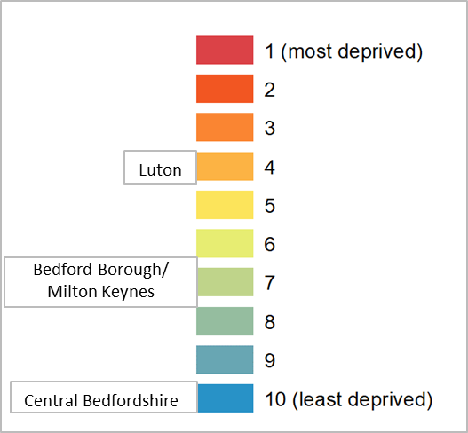

Population overview
The proportion of minority ethnic groups differs widely for the councils in BLMK:
6% (Central Bedfordshire),
20% (Bedford Borough/Milton Keynes),
45% (Luton)
Deprivation varies in our local authorities from least deprived to 4th more deprived.
You would expect better health outcomes in less deprived areas. However, at smaller geographical areas, this can vary to a greater degree which we may not be able to measure
The 10 year population projection estimates a change of between:
-3.8% (Luton) and 6.8% (Central Bedfordshire). The largest change for BLMK is for 16-24 (16%) and 65+ years (24%) (ONS)

Slide 6


Overview of MSK conditions
21%
of the Global Burden of Disease is due to MSK conditions in the UK.
Although MSK conditions tend to be long term they are less likely to be a cause of death. Many years of life can be impacted by disability and this is measured in years lived with disability (YLD). These make household, work and social activities harder, which also affect mental wellbeing and potentially lead to isolation.
725
people over 65 years old fractured their hip in BLMK (2020/21). Much of these ‘fragility fractures’ are due to osteoporosis so we need to target both the fractures and osteoporosis. Compared to the national average, the rate of falls in people over the age of 65 is significantly higher in Luton, Bedford is significantly lower. The Falls Pathway is currently being reviewed and re-designed.

Slide 7



National MSK Needs
About
10-30%
of GP consultations are accounted for by MSK conditions.
MSK conditions are
7.3%
of hospital admissions in England (2019-20) accounting for 1.26 million finished admission episodes.
Half
of the expected number of joint replacements were carried out in 2020 due to COVID-19, leaving a higher demand on the service.
Notes:
GP consultations: 2018- 21% were accounted for by MSK conditions but only 1 practice, visited 4 times over the year (BJGP). The other estimates were done 10-15 years ago
Half expected number: a study looking at calendar year 2019 comparing with 2020

Slide 8
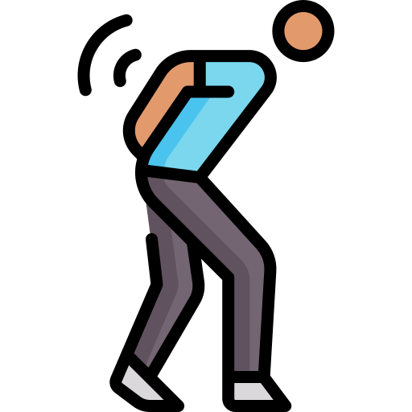

BLMK MSK Needs
30%
of the cases of work-related ill health are MSK conditions (second most common cause).
Average Quality of Life (QoL) score is close to
0.60
for people with MSK conditions living in BLMK CCG, significantly worse than adults without a long-term condition (0.92).
QoL
1.0
Better
Worse
0.0

Slide 9



Long-term MSK conditions
The prevalence of long-term MSK conditions nationally is
18.6%
The majority of these (13.2% of the total) have at least
2 long term conditions
The prevalence of long-term MSK conditions is between
14.9% - 17.5%
in the BLMK Local Authorities

Slide 10
Fit notes* for Employment
The median of mental health conditions and back pain is 3 weeks
The commonest fit notes for BLMK and England, 2017-21
 | Fit notes 2017-21 (episodes)
Diagnosis | BLMK | BLMK % | England %
Mental and behavioural disorders | 3,893 | 22.6% | 26.6%
Diseases of the musculoskeletal system and connective tissue | 2,759 | 16.0% | 14.5%
Diseases of the respiratory system | 1,825 | 10.6% | 8.1%
Symptoms, signs and abnormal clinical and laboratory findings | 988 | 5.7% | 7.0%
Factors influencing health status and contact with health services | 913 | 5.3% | 6.3%
Injury, poisoning and certain other consequences of external causes | 1,318 | 7.7% | 5.9%
Please note the above does not include diagnosis ‘Not Provided’ or ‘Unknown’
Source: NHS digital, 2021

Slide 11

Mental health needs in BLMK
We could do more to address the mental health of patients with MSK conditions.
20-26%
of patients in the Local Authorities in BLMK who report a long-term MSK problem also reports
depression or anxiety.
There are successful interventions to help mental health such as Improve Access to Psychological Therapies (IAPT) or cognitive behavioral therapy (CBT)

Slide 12



Preventative needs:
Notes:
Luton has the highest percentage of the population that are overweight or obese (70.7%), percentage of adults who are physically inactive (30.3%), and percentage of smokers (17.0%).
MK has a high smoking prevalence when compared with LA of a similar deprivation level (15.9%).

Slide 13
MSK services - community
Location | Bedford Borough and Central Bedfordshire | Luton | Milton Keynes
Provider | Circle Integrated Care | HRG Healthcare | Connect Health | Ravenscroft Health
Type of service | Triage, Treat and refer onwards Physiotherapy Conservative Management Therapies inc. injections, ultrasound-guided injections, Shockwave Therapy, and Apos Therapy Boots Nerve Conduction diagnostics Pain Management programmes Rheumatology in Early Inflammatory Arthritis Clinic | Triage, Treat and refer onwards Physiotherapy Conservative Management Therapies inc. injections, Pain management programmes | Tier 1 physiotherapy only Triage, Treat and refer onwards Physiotherapy | Tier 2+ Triage, Treat and refer onwards Pain Management programmes Conservative Management Therapies inc. injections, ultrasound-guided injections
Number of referrals received (2019/20) | 50,000 | 15,000 | 16,000 | 9,000
Notes:
Different contracts, comparison across each services difficult, opportunity to consolidate services

Slide 14
MSK services - pain and mental health
MSK services all provide varying levels of pain management services
Improving Access to Psychological Therapies (IAPT) offer help for common mental health problems such as anxiety and depression. IAPT service provides support for:
  Initial mental health diagnosis
  Psychological formulation/ bio-psycho-social approach to wellbeing
  A holistic view of managing MSK pain in addition to the physical component
IAPT receives self referral and referrals from GP and community services

Slide 15
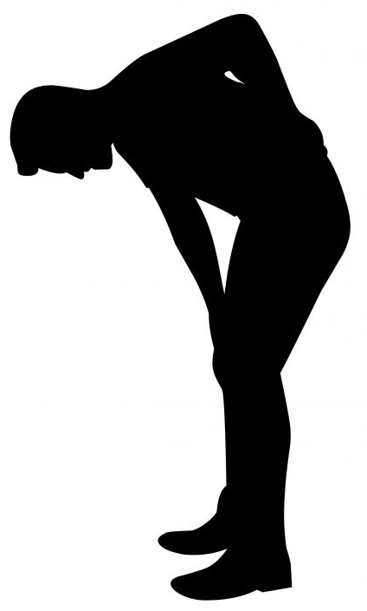
MSK services – secondary care
Lower back pain
The table below shows the most common non-elective (emergency) admissions for MSK conditions in BLMK. ‘Other’ includes a variety of conditions that individually have very low numbers, such as osteomyelitis. The figures for 2020 & 2021 were reduced due to the pandemic.
Lower back pain is the most frequent- this is a potential target to reduce emergency admissions.
Condition | 2017 | 2018 | 2019 | 2020 | 2021
Arthrosis | 15 | 25 | 33 | 18 | 6
Gout | 40 | 71 | 74 | 43 | 52
Juvenile | 4 | 5 | 6 | 4 | 1
Lower Back Pain | 201 | 325 | 306 | 191 | 156
Osteoporosis | 8 | 2 | 7 | 7 | 0
Rheumatoid | 26 | 33 | 21 | 22 | 13
Other | 210 | 274 | 307 | 286 | 213
Total | 525 | 772 | 800 | 622 | 473

Slide 16
Impact of Covid on MSK Services
During 2020, routine elective orthopaedic procedures and consultations were cancelled leaving a back log of patients waiting to be seen. In October 2021, 2,350 patients were waiting for procedures and a further 4,350 for consultations.
Knee replacement waiting time: 45 weeks
Hip replacement waiting time: 56 weeks
In November 2021, over 4,000 patients were waiting over 10 weeks for treatment in the community, half of these were for level 1 Physiotherapy.
In the community, there are multiple challenges in the services:
staff sickness or redeployment
lack of appointments and increased waiting times.
increase in complexity of patients
potential communication gap between clinicians and patients

Slide 17
System-level recommendations
Prevention services in primary and community settings should:
Promote physical activity in all ages
Increase smoking cessation support, targeted to areas of higher prevalence
Strengthen MSK service links with the falls prevention pathway, which is currently under review
Strengthening MSK services in the community would reduce inappropriate demands on acute care. MSK services should focus on:
Community and digital-based interventions to empower patients’ self management
Multi-disciplinary care models which incorporates a wider range of clinical and non-clinical staff to support patients, with posts such as:
  First contact MSK practitioners
  Social prescribers and care co-ordinators
  Physiotherapist, pain and mental health professionals

Slide 18
System-level recommendations
Referral pathways should be lean and clear between primary, community and secondary care
Secondary care should support community care to facilitate diagnostics and therefore early diagnosis
Communication regarding patient care should be streamlined between all providers including MDTs where appropriate
Communication channels should be kept open between services and the patient
Contract management should ensure standardisation of service performance and provision across BLMK

Slide 19
System-level recommendations
Assistance should be provided for patients awaiting definitive treatment to ensure they do not deteriorate. This would include signposting to self-help groups, exercise classes, weight management, pain management, social services, Occupational Therapy (OT) and IAPT
There should be standardisation of outcome measures across BLMK in community services
Minimum data sets should be standardised across services to enable informed decision-making and benchmarking

Slide 20
Pain and mental health services recommendations
Specifically for lower back pain, primary care services should consider how to risk stratify young people and adults presenting with a new episode of low back pain with or without sciatica based on biological, psychological, and social factors
Use of opioids, spinal injections, and imaging should follow clinical guidelines
To increase access and engagement, a hybrid digital and face-to-face service should be offered, and patient outcomes should be monitored for these initiatives

Slide 21
Pain and mental health services recommendations
There should be a higher level of awareness of mental health needs in community MSK services, e.g. physiotherapist and GP to consider IAPT referral in chronic MSK patients
The system should ensure patient records are shared between relevant services as appropriate to improve patient care e.g. community MSK service and IAPT to improve patient care

Slide 22
References
Population
Ethnicity- https://www.ons.gov.uk/peoplepopulationandcommunity/populationandmigration
Deprivation- https://fingertips.phe.org.uk/
Population projection- https://www.ons.gov.uk/peoplepopulationandcommunity/populationandmigration
MSK conditions
Global Burden of Disease- https://vizhub.healthdata.org/gbd-compare
MSK long-term conditions, mental health & preventative needs
https://fingertips.phe.org.uk/profile/msk/data#page/1
MSK Needs
Work-related health- https://www.hse.gov.uk/statistics/cost.htm
Quality of Life- https://www.versusarthritis.org/
Fit notes
NHS digital, 2021- https://digital.nhs.uk/services/fit-notes

