Slide 1

Indices of Deprivation 2019
Bedford Borough Council
Indices of Deprivation 2019
Bedford Borough
Produced by
Population Health, Evidence & Intelligence
April 2020

Slide 2







Indices of Deprivation 2019
Bedford Borough
Introduction
The Index of Multiple Deprivation (IMD) is the official measure of relative deprivation in England and is part of a series of outputs making up the Indices of Deprivation (IoD). This briefing presents the headline findings from IoD 2019 and changes from the 2015 position. IoD combine 39 indicators into seven distinct domains of deprivation covering: income; employment; education; health; crime; housing; and environment(see figure 3). The IoD gives an indication of the extent of different types of deprivation experienced in neighbourhoods (or lower super output areas, LSOAs). All neighbourhoods in England are ranked according to their level of deprivation relative to other areas. Average measures are also available at local authority level.
Overall Deprivation
Bedford ranks 96/151 upper tier and unitary local authorities (where 1 is most deprived) and 150/317 lower tier and unitary local authorities. 14/103 LSOAs in Bedford are ranked in the most deprived 20% nationally, with 4 among the most deprived 10%.
The wards with the most deprived LSOAs are Cauldwell, Castle and Harpur.
Income
The wards which contain the most deprived LSOAs are Cauldwell, Kingsbrook and Castle.
From 2015 to 2019, the number of LSOAs within the most deprived 20% and 10% in England, fell from 20 to 17 and 6 to 5 respectively.
Employment
The wards of Goldington, Harpur and Castle are the most deprived.
There was an improvement in the number of areas within the top 10 most deprived from 6 to 4, whilst there was no change in the top 20 which stayed at 19 areas.
Income deprivation affecting older people
The most deprived wards are Harpur, Castle and Kingsbrook.
Between 2015 to 2019, saw an increase in the number of top 10 and top 20% most deprived LSOAs nationally from 6 to 7 and 11 to 12 respectively.
Income deprivation affecting children
The most deprived LSOAs can be found in the wards of Putnoe, Castle and Cauldwell.
2015 to 2019 saw a drop from 16 to 14 LSOAs within the 20% most deprived whilst those in the top 10% fell from 5 to 1.
Education Skills and Training
The wards that contain the highest deprivation are Goldington, Cauldwell and Queen’s park.
There was a decrease in the number of LSOAs in the top 10 most deprived nationally from 6 to 2, whilst the top 20 saw an increase from 19 to 20 areas.
Children and Young People
There has been a reduction in the number of areas in the top 20 and top 10 from 23 to 17 and 5 to 1 respectively.
The most deprived LSOAs are in Putnoe, Goldington and Harpur.
See page 16 for a table that shows the wards that are most deprived in each of the domains.

Slide 3





Indices of Deprivation 2019
Bedford Borough
Crime
There has been a reduction in the number of LSOAs in the most deprived 10% from 5 to 4 whilst the top 20% has seen an increase from 10 to 11 areas.
The areas which are most deprived are Harrold, Castle and Harpur.
Barriers to Housing and Services
There was no change in the top 10% at 14 areas but has been an increase in the top 20% from 28 to 29.
The most deprived areas are Elstow & Stewartby, Oakley, Sharnbrook, Harrold, Riseley, Great Barford and Wyboston.
Living Environment
The top 20 most deprived living environments saw an increase from 16 to 17, whilst the top 10 did not change, remaining at 2.
The areas which are most deprived are Wyboston, Riseley, and Harpur.
Adult Skills
There have been no changes since 2015, with both the top 10 and top 20% staying at 8 and 19 areas apiece.
The areas which suffer from the highest deprivation are Queen’s Park, Kingsbrook and Castle.
Health Deprivation & Disability
There has been an increase in areas among the most deprived LSOAs nationally for health deprivation and disability. The number of areas in the top 20% rose from 10 to 12 and the top 10% from 2 to 7 areas.
The areas which are most deprived are Harpur, De Parys, Castle and Cauldwell.
Figure 1: Change in the number of LSOAs in Bedford which rank in the top 20 and top 10% nationally from 2015 to 2019
Domain | LSOAs among top 20% |  |  | LSOAs among top 10%
 | 2015 | 2019 | Change | 2015 | 2019 | Change
Income | 20 | 17 | -3 | 6 | 5 | -1
Income deprivation affecting children | 16 | 14 | -2 | 5 | 1 | -4
Income deprivation affecting older people | 11 | 12 | +1 | 6 | 7 | +1
Employment | 19 | 19 | - | 6 | 4 | -2
Education Skills and Training | 19 | 20 | +1 | 6 | 2 | -4
Children and Young People | 23 | 17 | -6 | 5 | 1 | -4
Adult Skills | 19 | 19 | 0 | 8 | 8 | 0
Health Deprivation & Disability | 10 | 12 | +2 | 2 | 7 | +5
Crime | 10 | 11 | +1 | 5 | 4 | -1
Barriers to Housing and Services | 28 | 29 | +1 | 14 | 14 | 0
Living Environment | 16 | 17 | +1 | 2 | 2 | 0

Slide 4
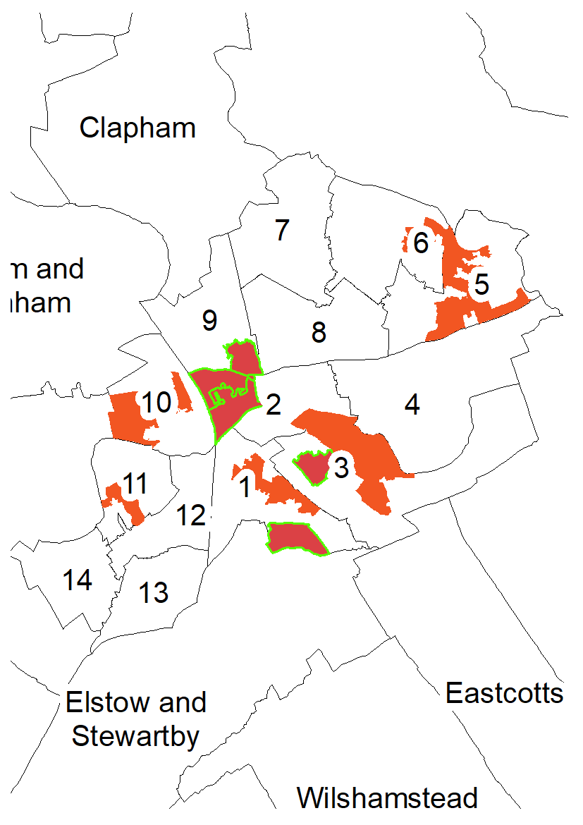
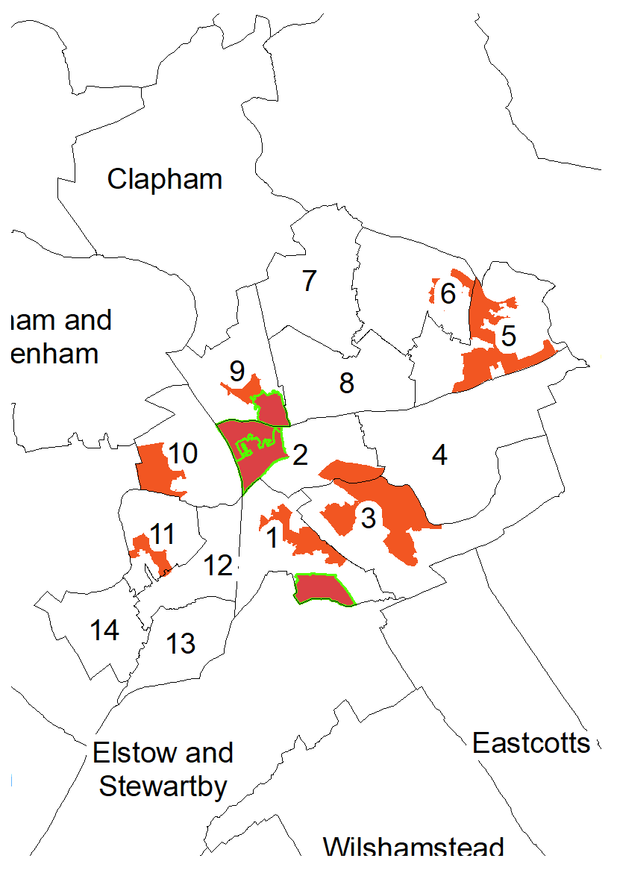
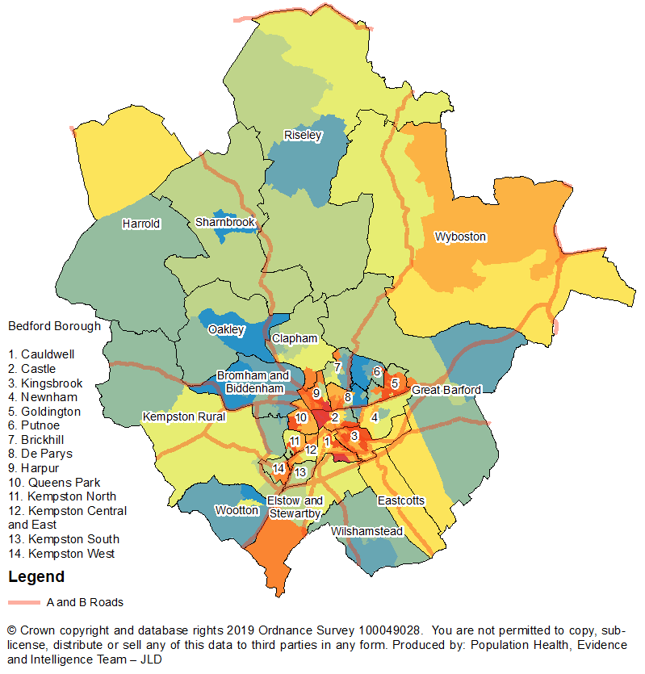
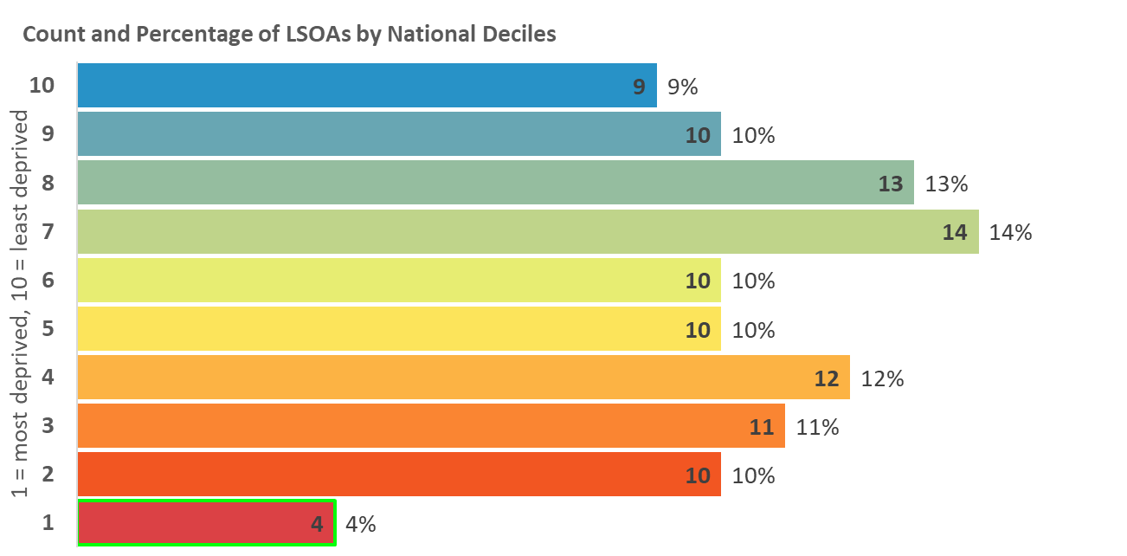
Indices of Deprivation 2019
Bedford Borough
Index of Multiple Deprivation
The overall Index of Multiple Deprivation (IMD) is a weighted measure based on information
relating to income, employment, education, health, crime, housing, and environment.
Map 1: Distribution of the Index of Multiple Deprivation 2019
LSOAs amongst the most deprived 10% and 20% in England
2015
2019
Legend
10% most deprived
20% most deprived

Slide 5
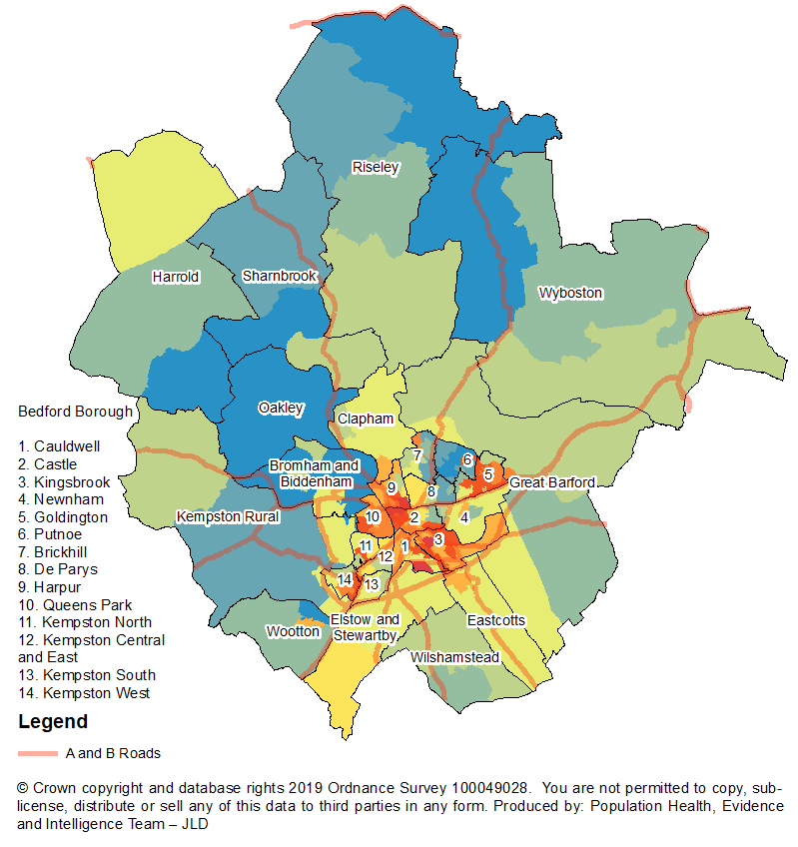
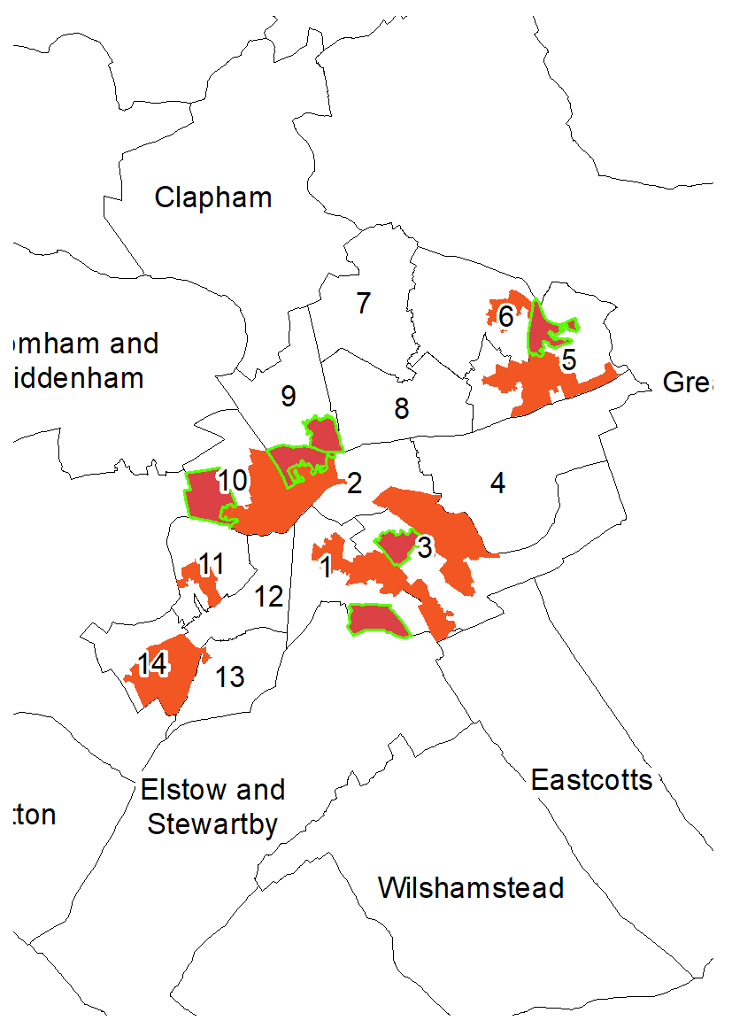
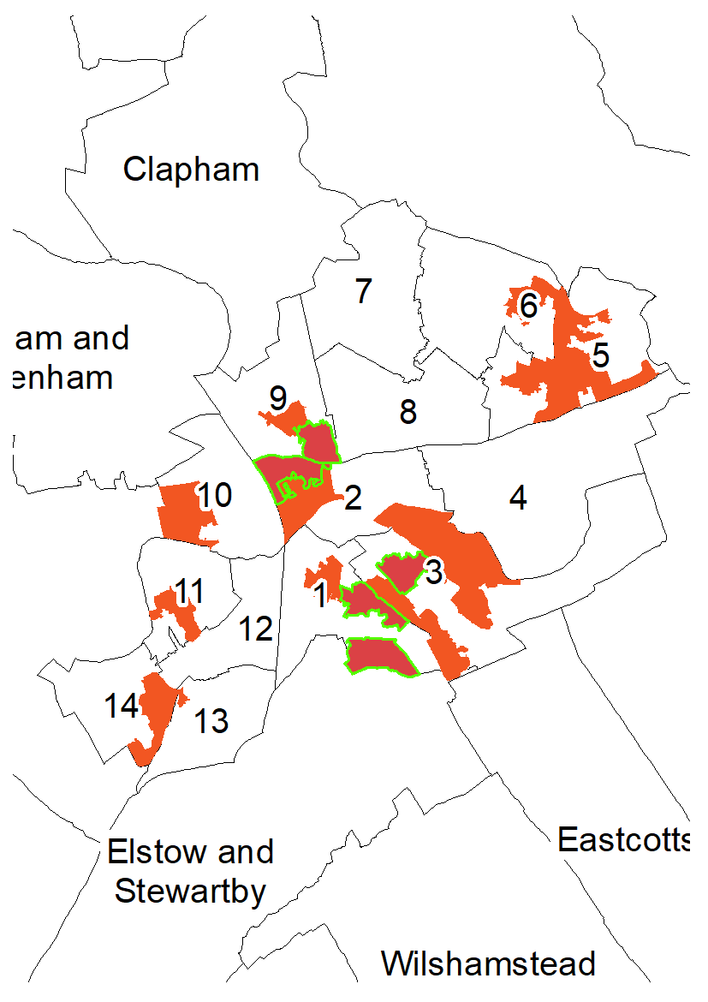
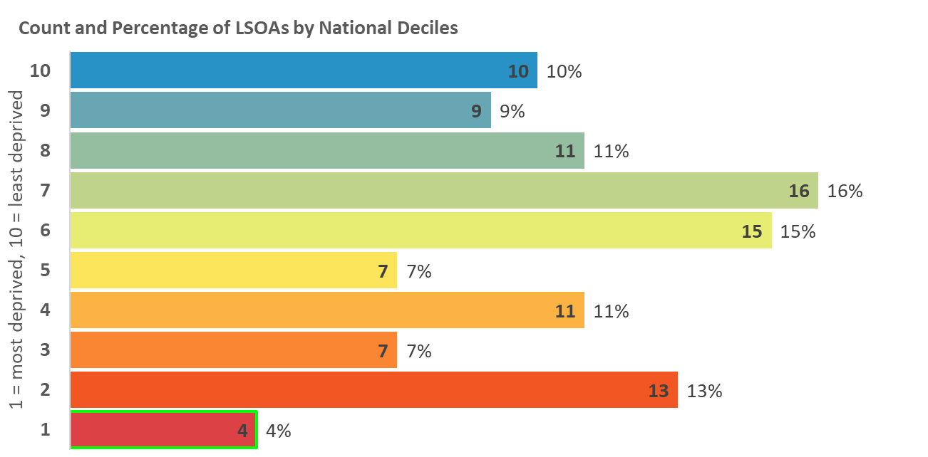
Indices of Deprivation 2019
Bedford Borough
Income Deprivation
The proportion of the population in an area experiencing deprivation relating to low income. Low income includes both those people that are out-of-work, and those in work but have low earnings.
Map 2: Distribution of Income Deprivation 2019
LSOAs amongst the most deprived 10% and 20% in England
2015
2019
Legend
10% most deprived
20% most deprived

Slide 6
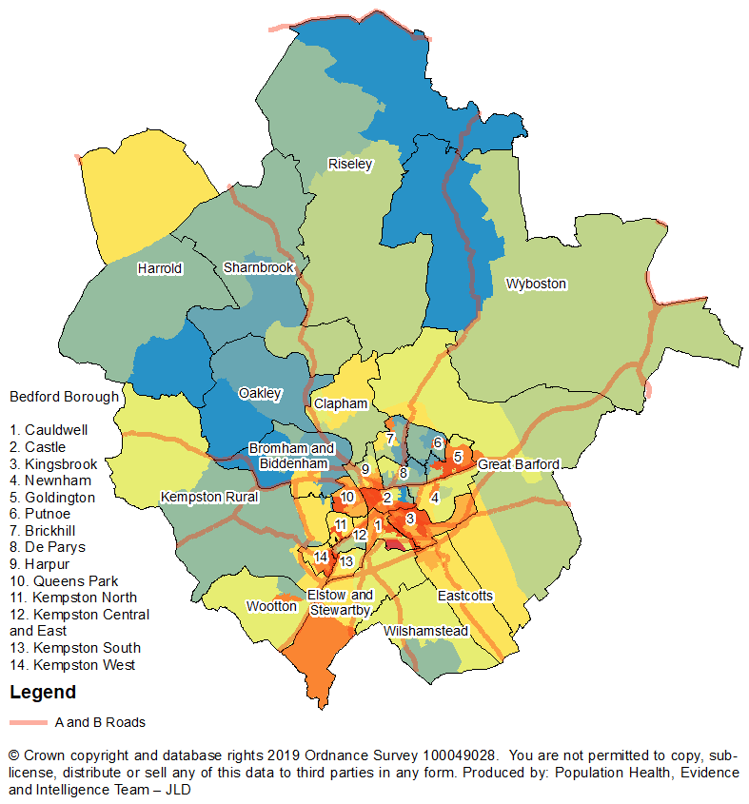
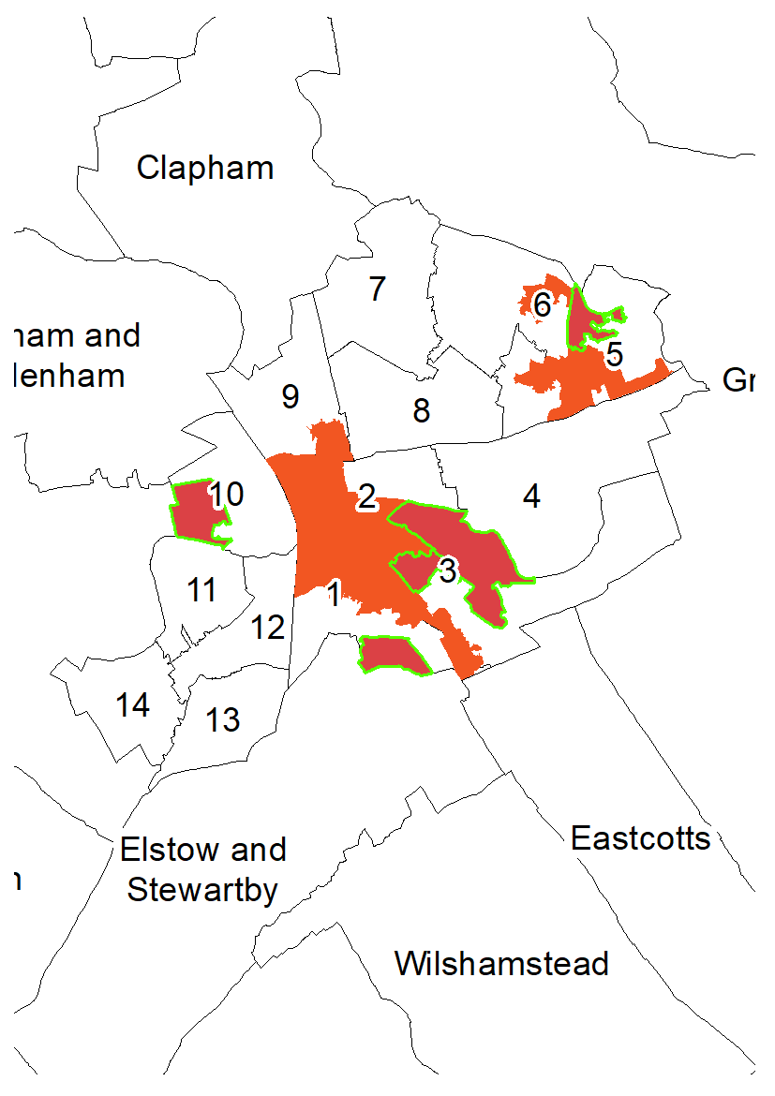
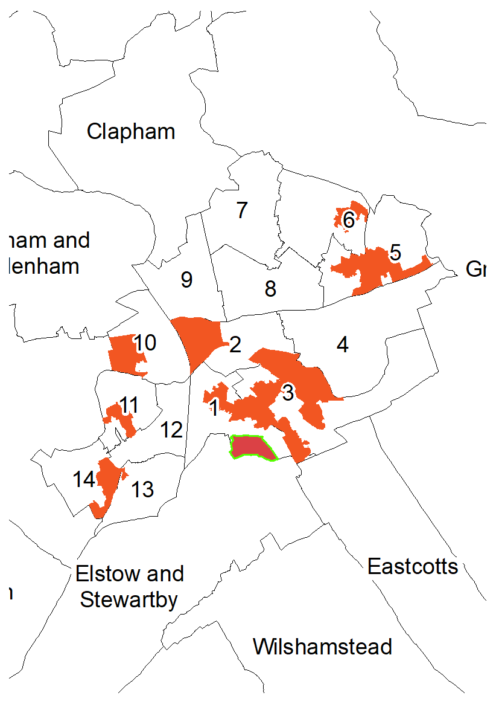
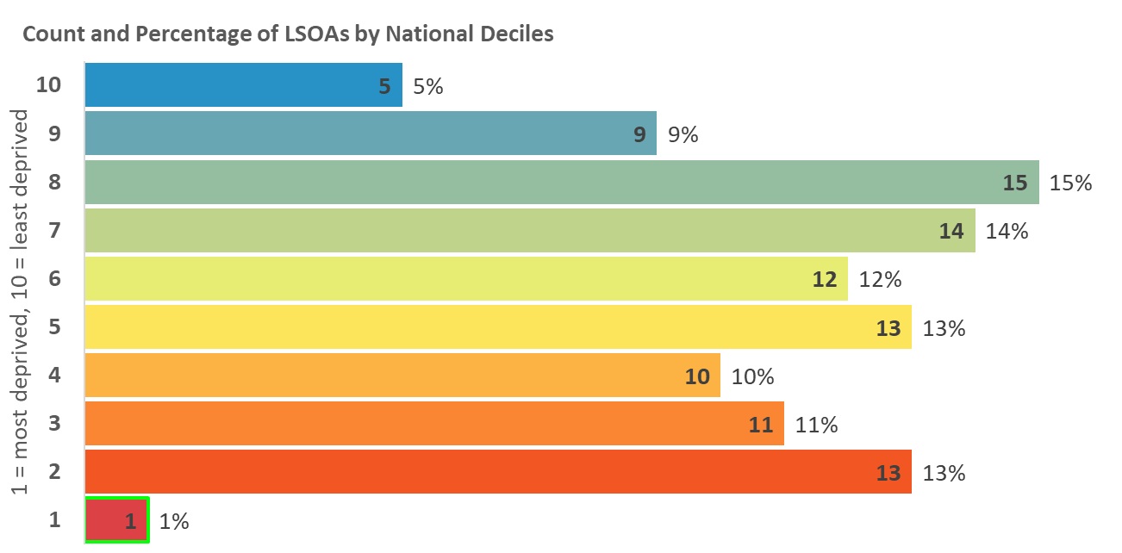
Indices of Deprivation 2019
Bedford Borough
Income Deprivation Affecting
Children Index (IDACI)
A subset of the Income Deprivation Domain. The proportion of children (0-15) in each LSOA that live in families that are income deprived; those that are in receipt of Income Support, income-based Jobseeker’s Allowance, Pension Credit Guarantee or Working/Child Tax Credit below a given threshold.
Map 3: Distribution of IDACI 2019
LSOAs amongst the most deprived 10% and 20% in England
2015
2019
Legend
10% most deprived
20% most deprived

Slide 7
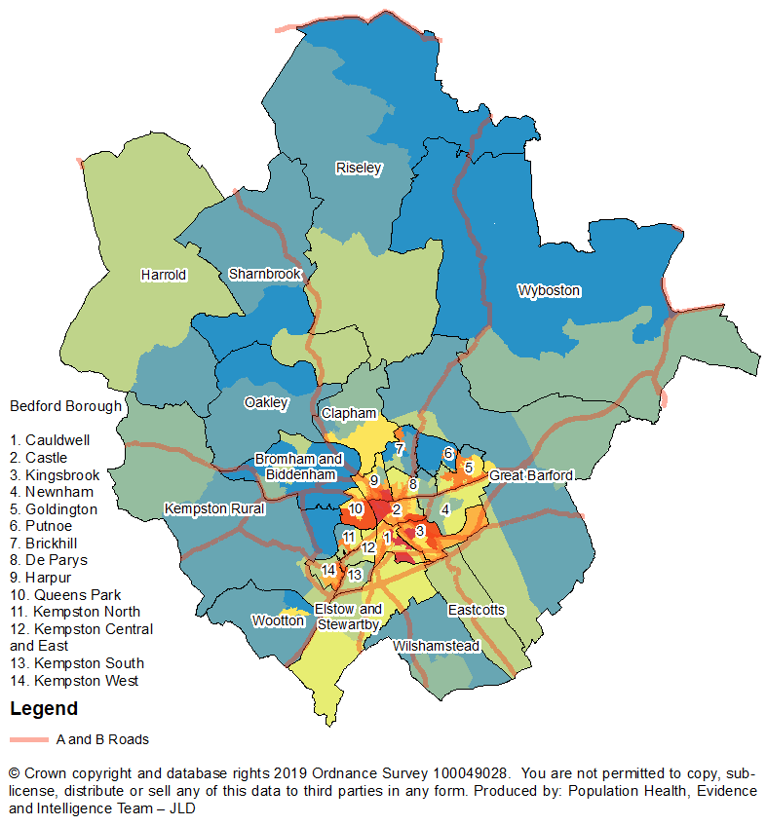
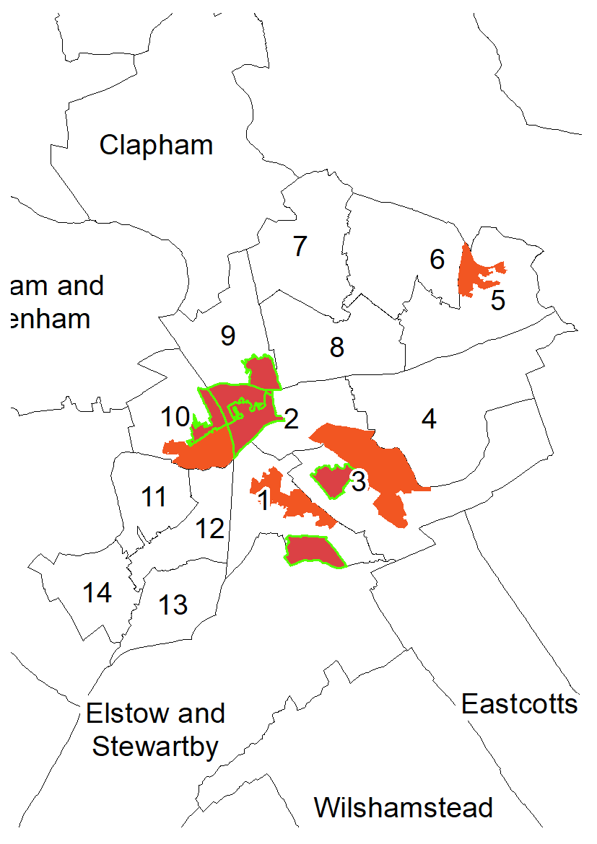
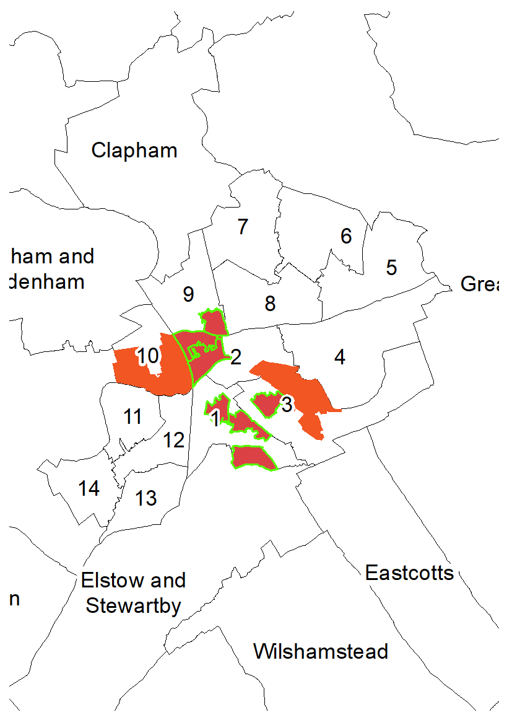
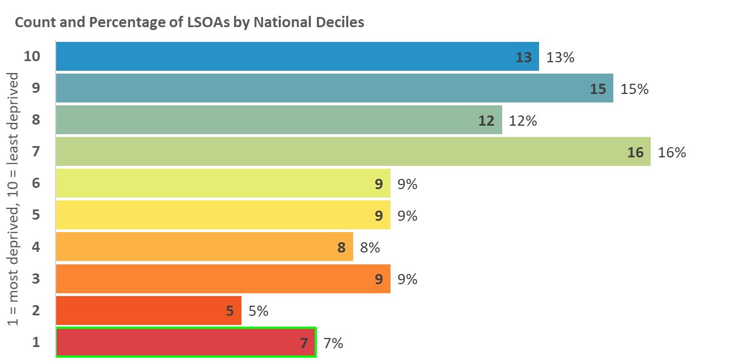
Indices of Deprivation 2019
Bedford Borough
Income Deprivation Affecting
Older People (IDAOPI)
A subset of the Income Deprivation Domain. The proportion of a LSOAs population aged 60 and over receiving Income Support, income-based Jobseekers Allowance, income-based Employment and Support Allowance, or Pension Credit (Guarantee).
Map 4: Distribution of IDAOPI 2019
LSOAs amongst the most deprived 10% and 20% in England
2015
2019
Legend
10% most deprived
20% most deprived

Slide 8
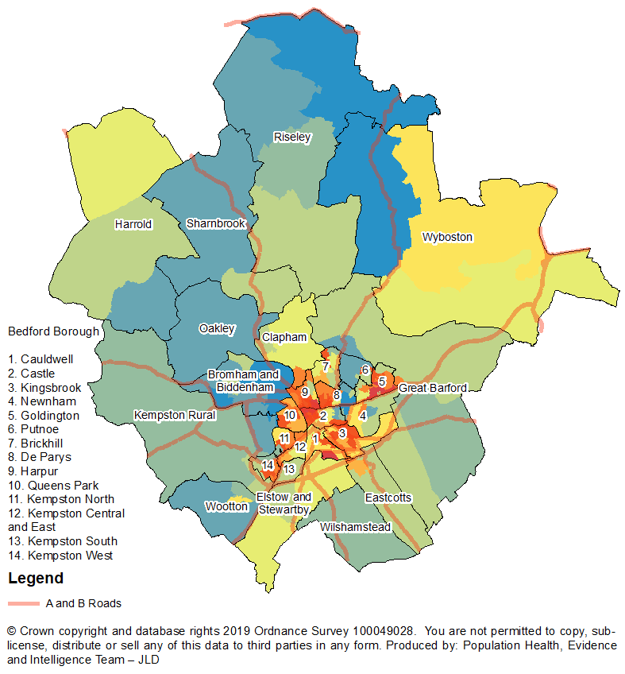
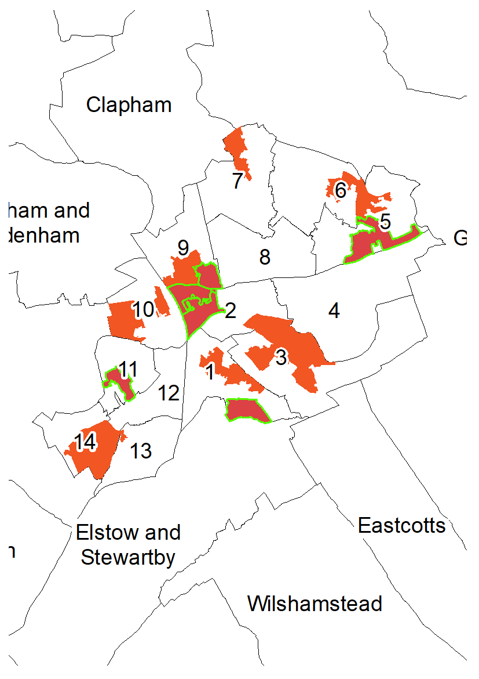
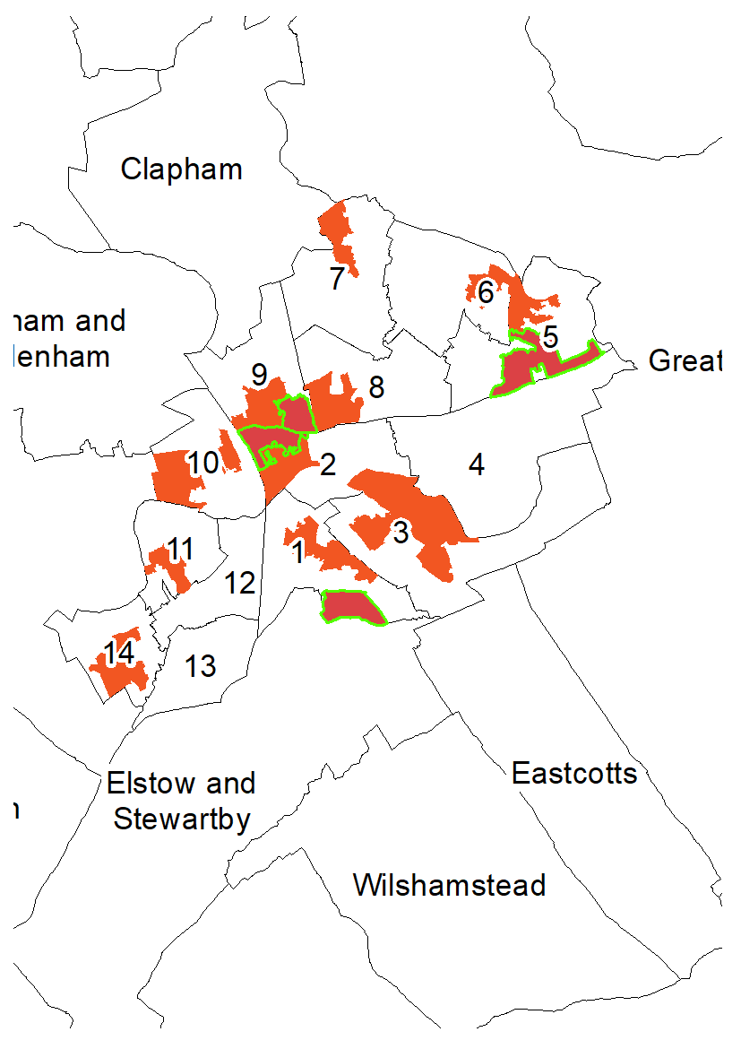
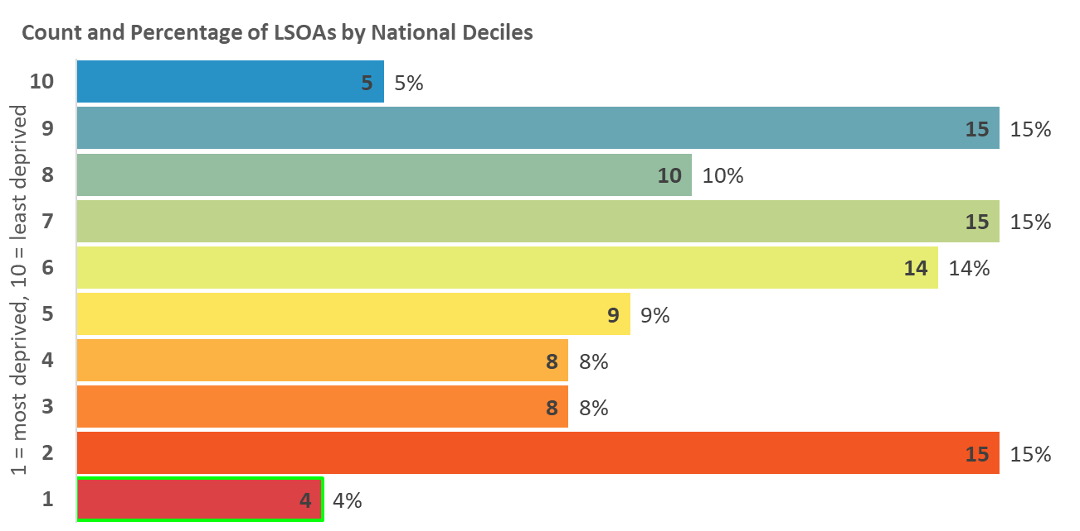
Indices of Deprivation 2019
Bedford Borough
Employment Deprivation
The proportion of the working age population involuntarily excluded from the labour market. Indicators included are claimants of Jobseekers’ Allowance, Employment and Support Allowance, Incapacity Benefit, Severe Disablement Allowance, and Carer’s Allowance.
Map 5: Distribution of Employment Deprivation 2019
LSOAs amongst the most deprived 10% and 20% in England
2015
2019
Legend
10% most deprived
20% most deprived

Slide 9
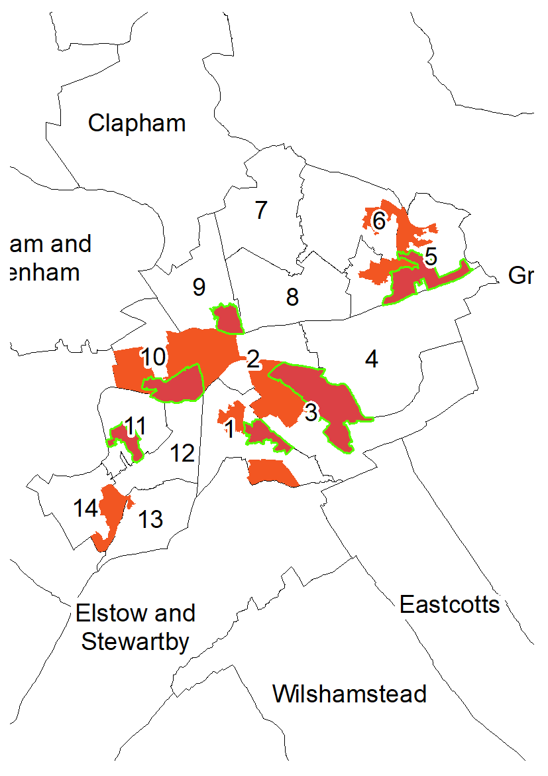
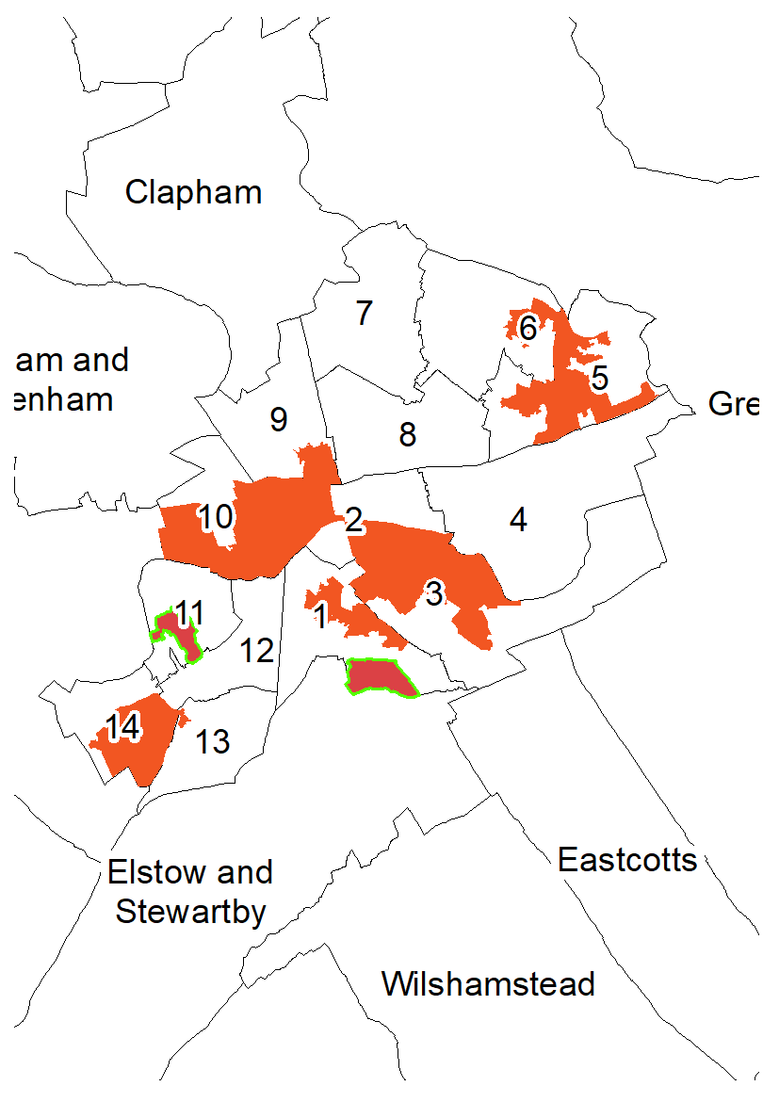
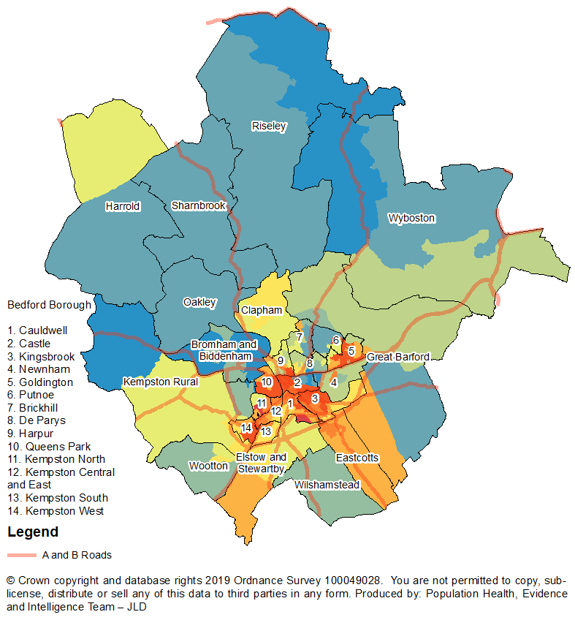
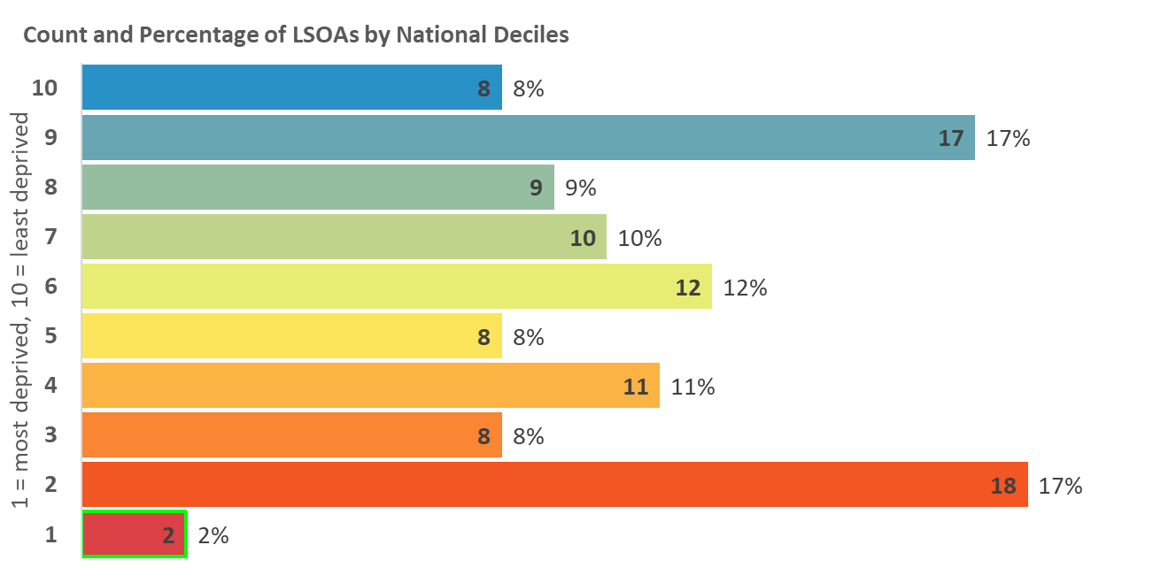
Indices of Deprivation 2019
Bedford Borough
Education, Skills and Training
Deprivation
Measures the lack of attainment and skills in the local population. The indicator is related to two sub-domains: children and young people as well as adult skills. These two sub-domains reflect the ‘flow’ and ‘stock’ of educational disadvantage within an area respectively.
Map 6: Distribution of Education, Skills and Training
Deprivation 2019
LSOAs amongst the most deprived 10% and 20% in England
2015
2019
Legend
10% most deprived
20% most deprived

Slide 10
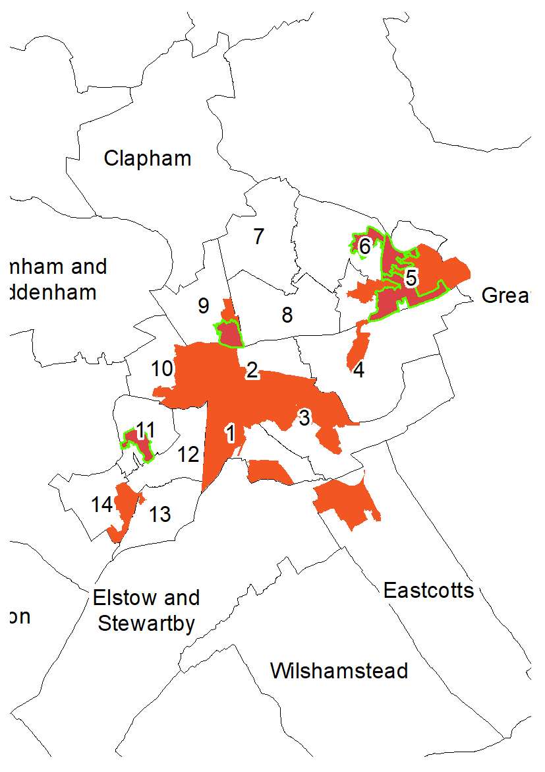
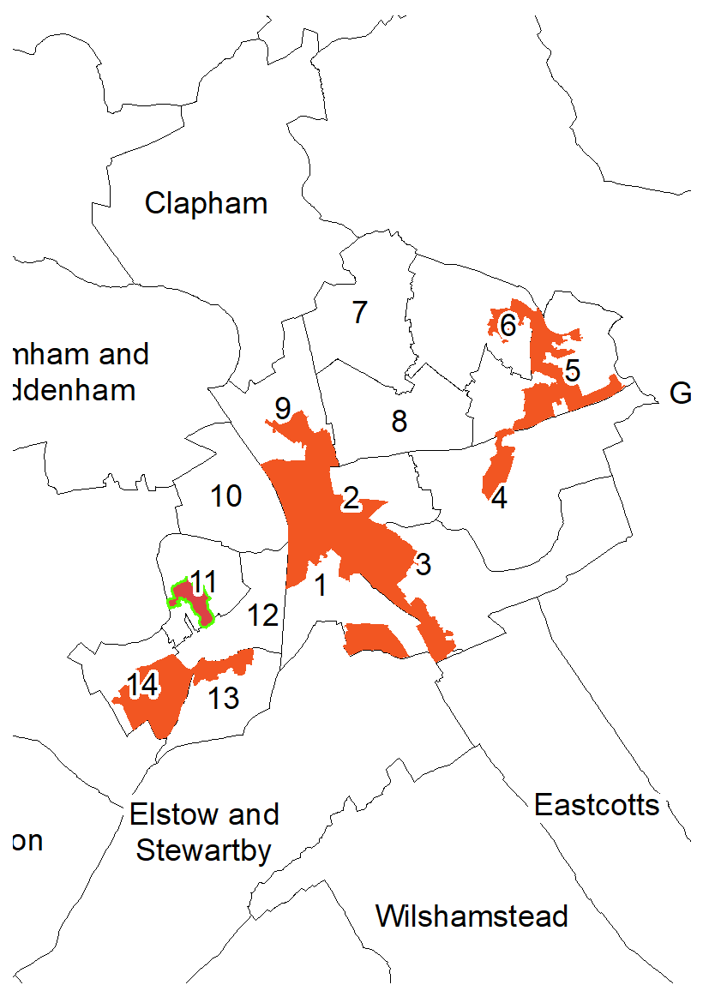
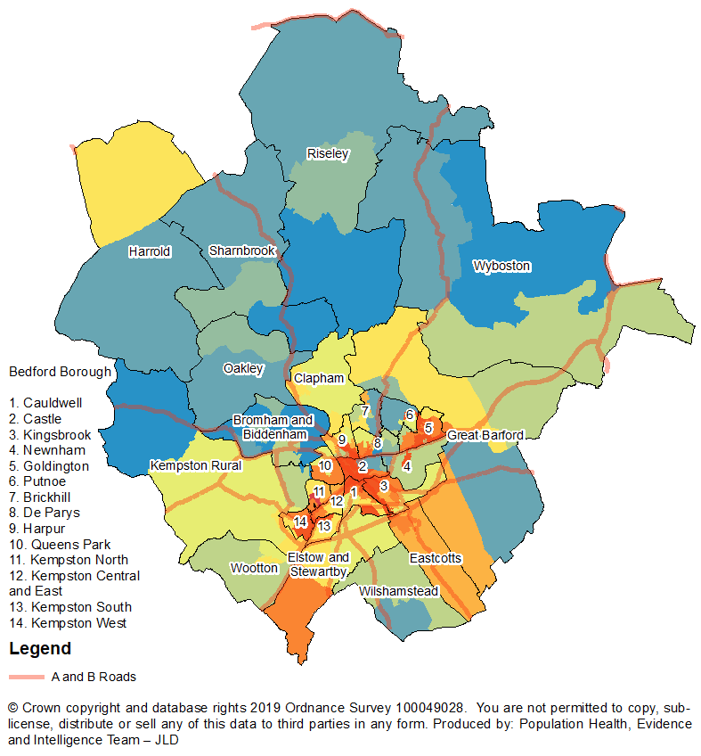
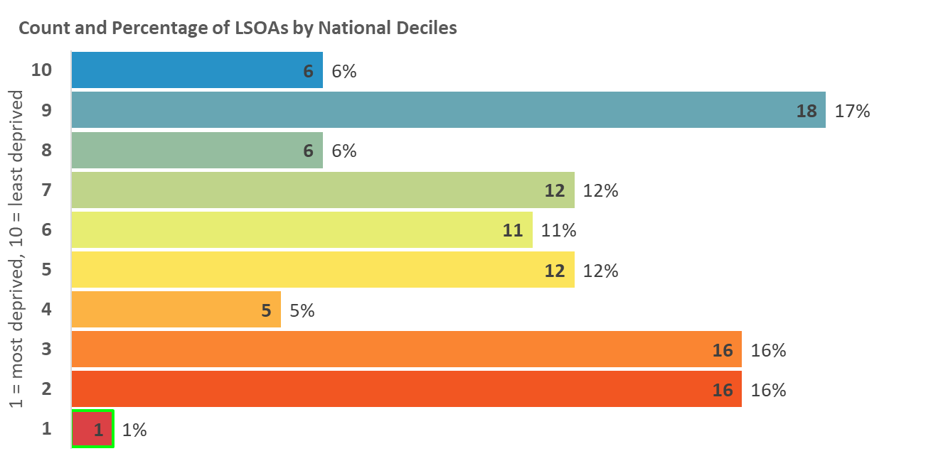
Indices of Deprivation 2019
Bedford Borough
Children and Young People
Deprivation
Measure based on average points score for Key Stage 2 and 4 attainment, proportion of secondary school (authorised and unauthorised) absences, proportion of young people not staying on in education above age 16, and young people aged 21 not entering higher education.
Map 7: Distribution of Children and Young People
Deprivation 2019
LSOAs amongst the most deprived 10% and 20% in England
2015
2019
Legend
10% most deprived
20% most deprived

Slide 11
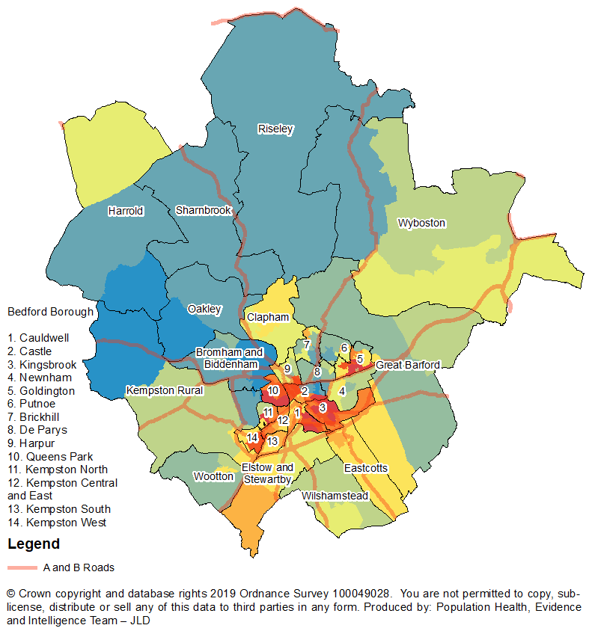
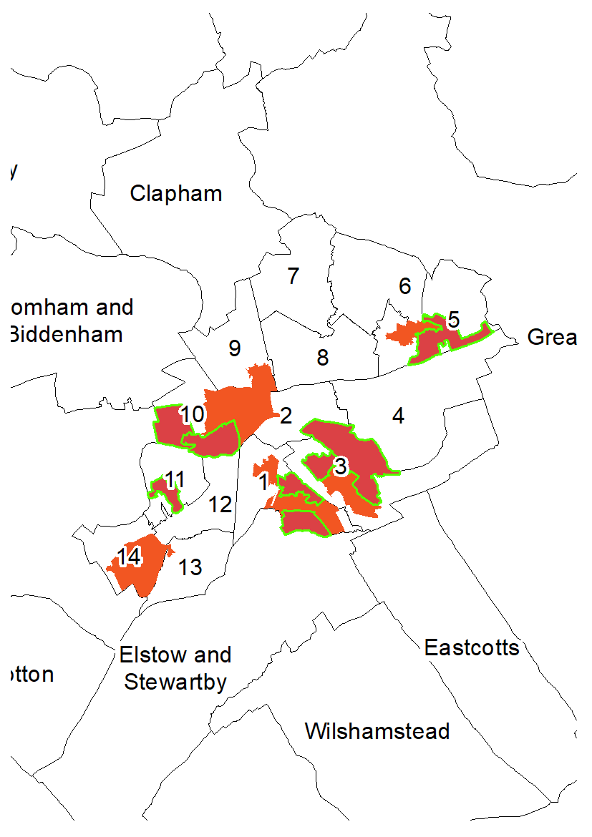
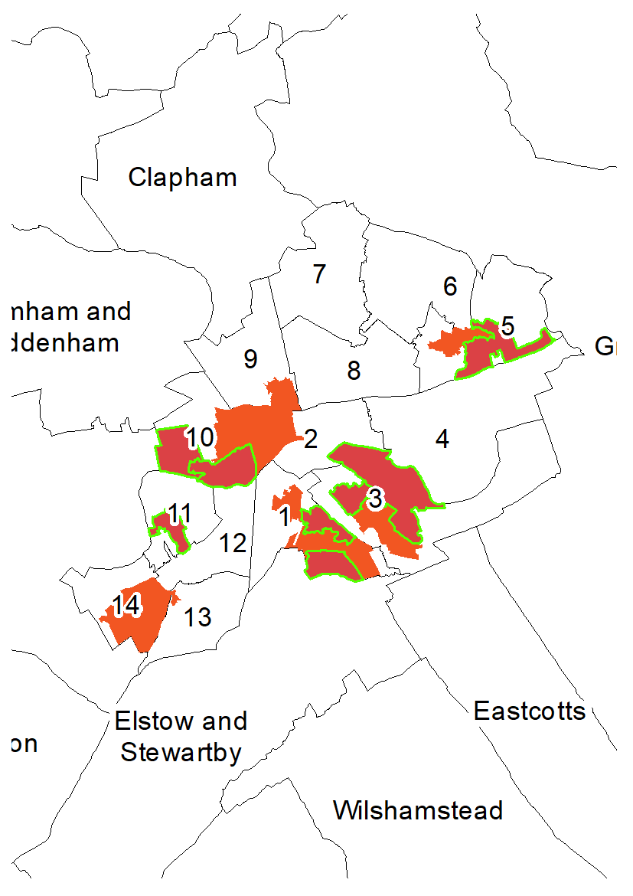
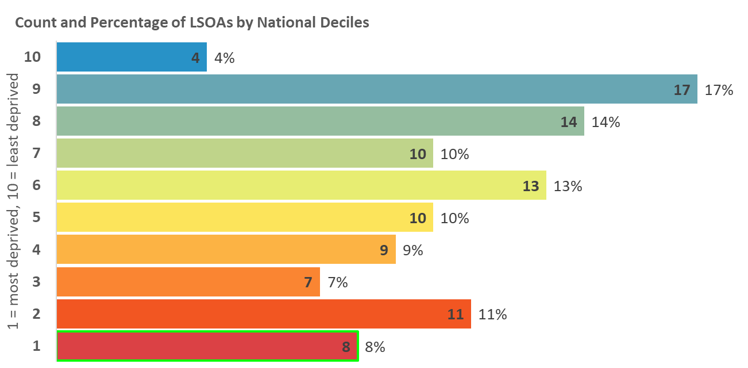
Indices of Deprivation 2019
Bedford Borough
Adult Skills Deprivation
Based on two indicators: Adult skills and English language proficiency. Adult skills is the proportion of working age adults with no or low qualifications. English language proficiency is the proportion of working age adults who cannot speak English or cannot speak English well.
Map 8: Distribution of Adult Skills Deprivation 2019
LSOAs amongst the most deprived 10% and 20% in England
2015
2019
Legend
10% most deprived
20% most deprived

Slide 12
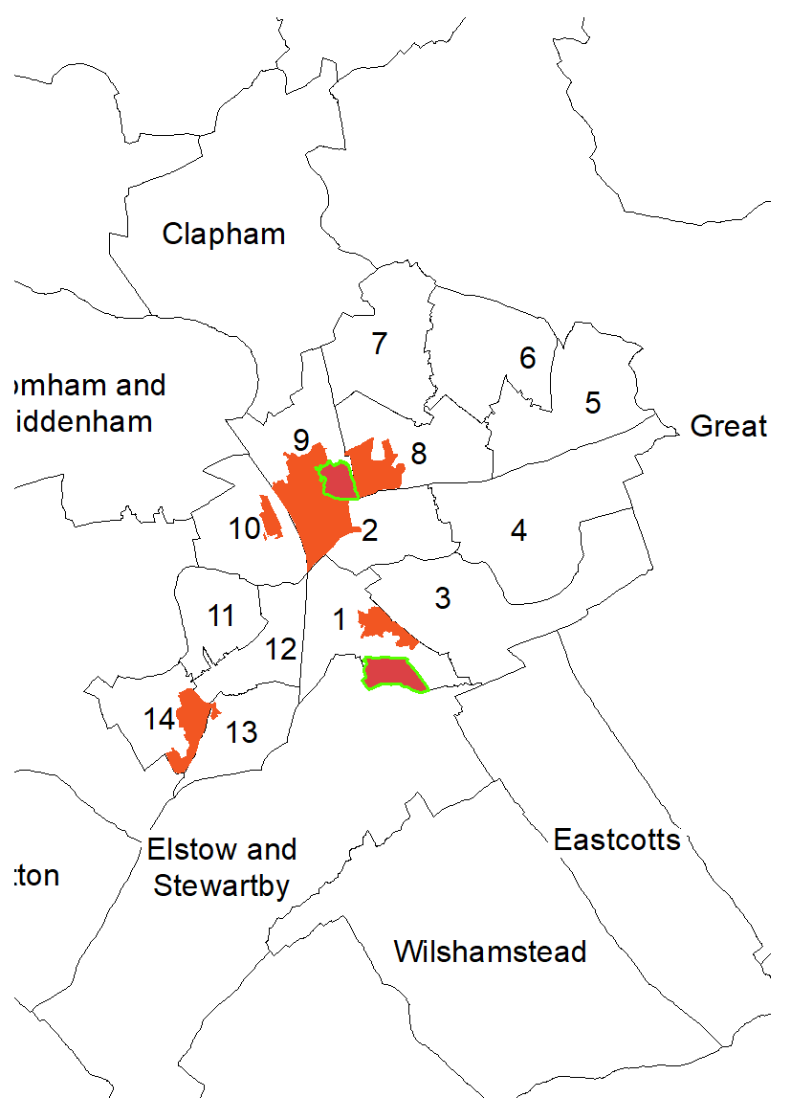
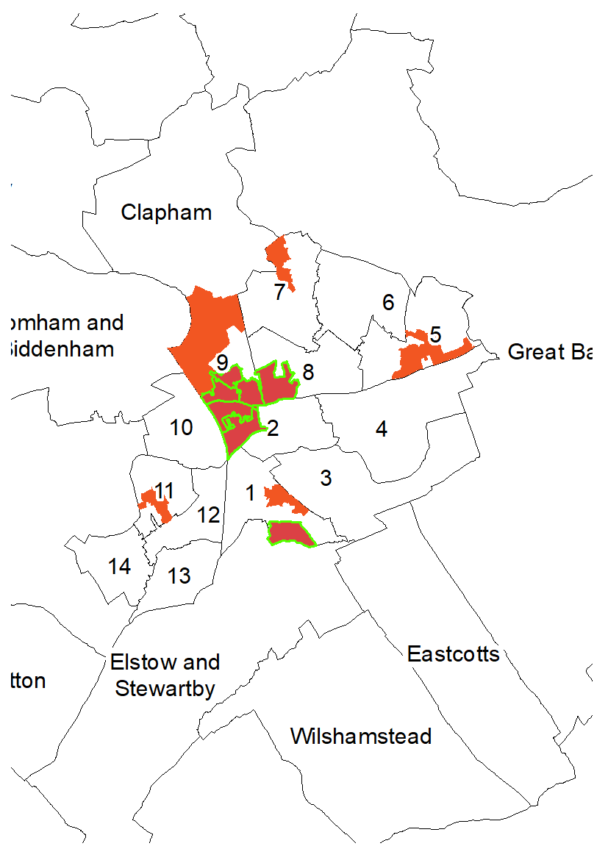
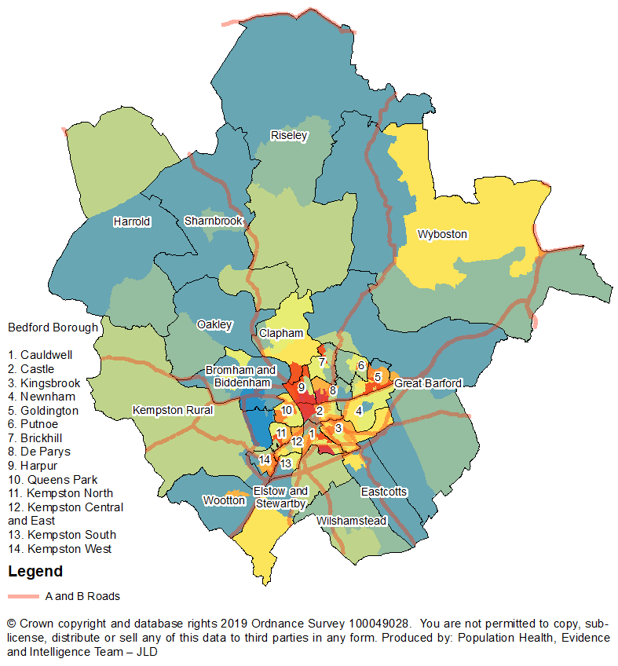
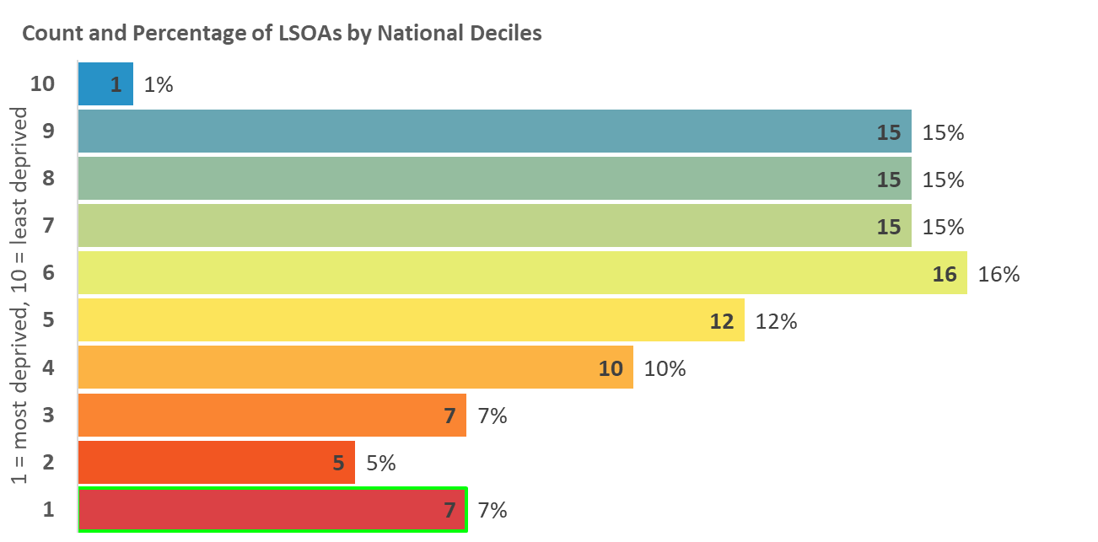
Indices of Deprivation 2019
Bedford Borough
Health Deprivation and Disability
Deprivation
Measures the risk of premature death and the impairment of quality of life through poor physical or mental health. The domain measures morbidity, disability and premature mortality but not aspects of behaviour or environment that may be predictive of future health deprivation.
Map 9: Distribution of Health and Disability Deprivation 2019
LSOAs amongst the most deprived 10% and 20% in England
2015
2019
Legend
10% most deprived
20% most deprived

Slide 13
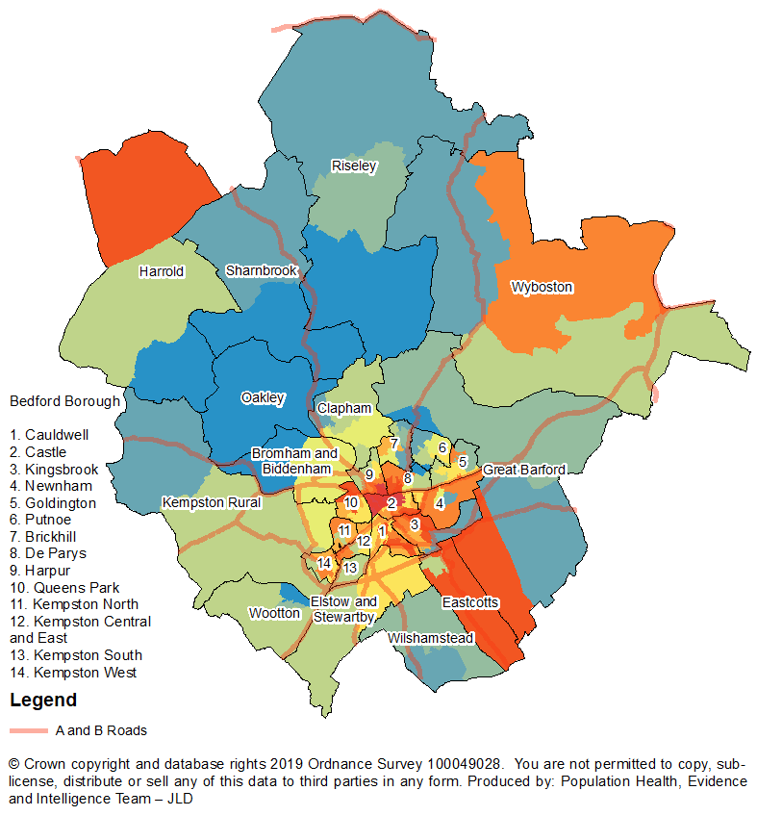
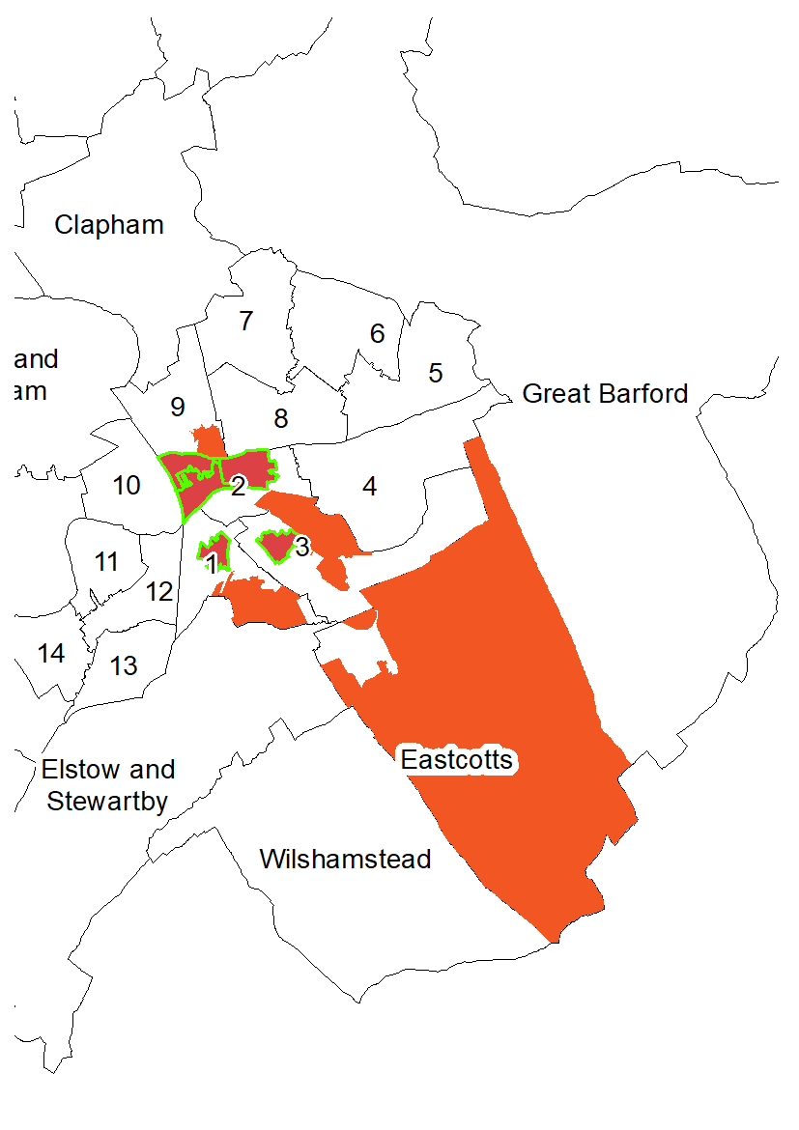
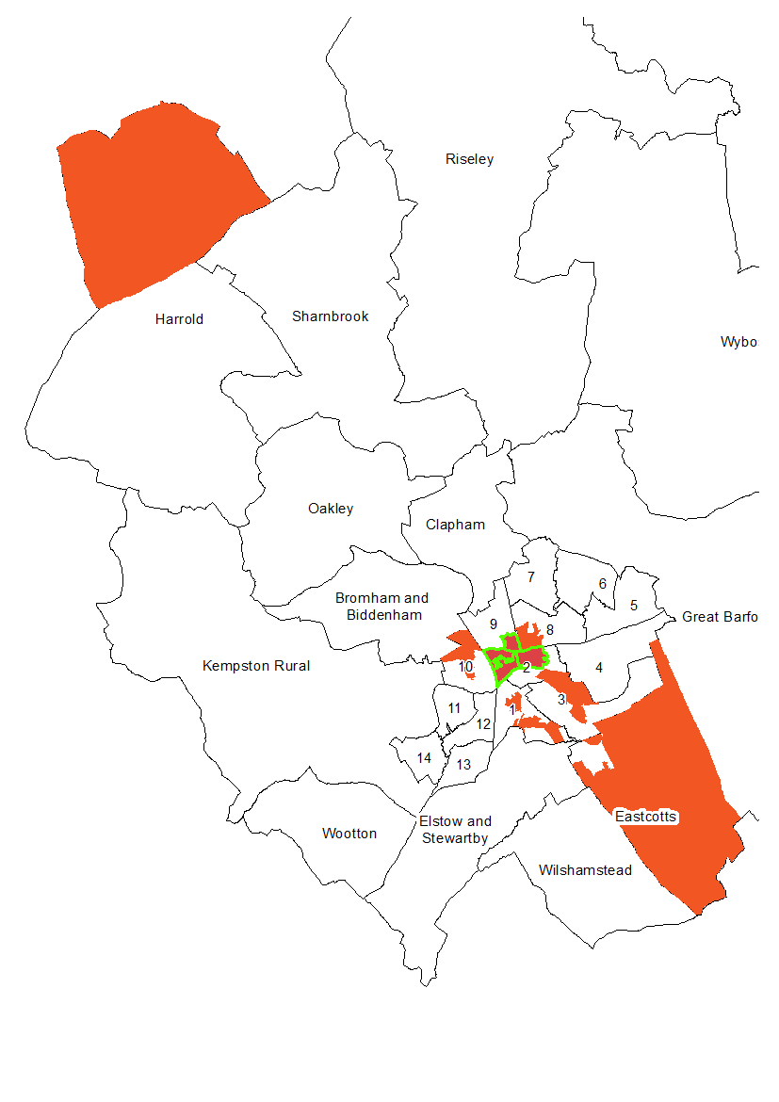
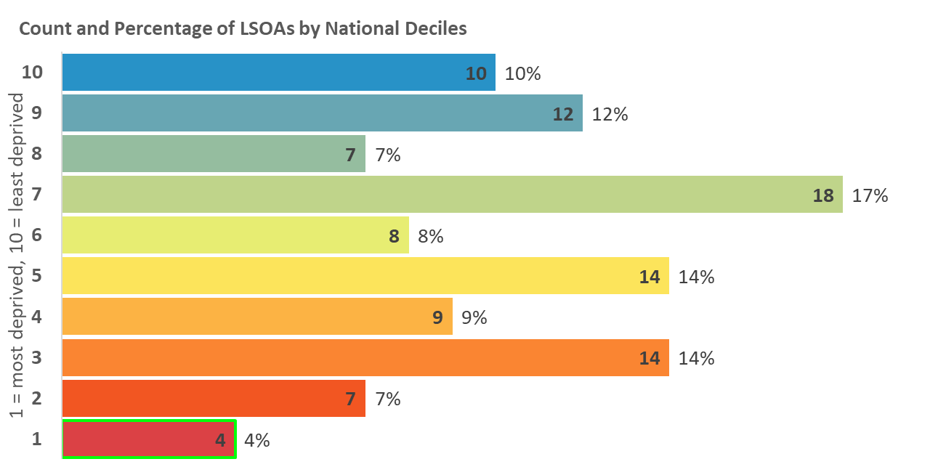
Indices of Deprivation 2019
Bedford Borough
Crime Deprivation
Measures the risk of personal and material victimisation at local level. Based on the numbers of reported crime types relating to violence, burglary, theft, and criminal damage.
Map 10: Distribution of Crime Deprivation 2019
LSOAs amongst the most deprived 10% and 20% in England
2015
2019
Legend
10% most deprived
20% most deprived

Slide 14
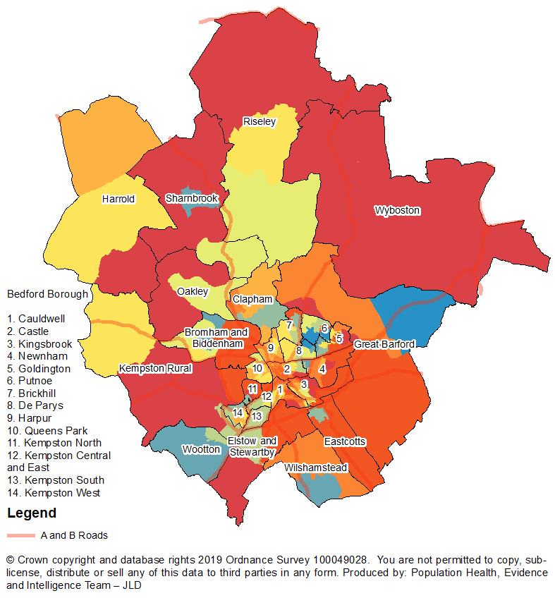
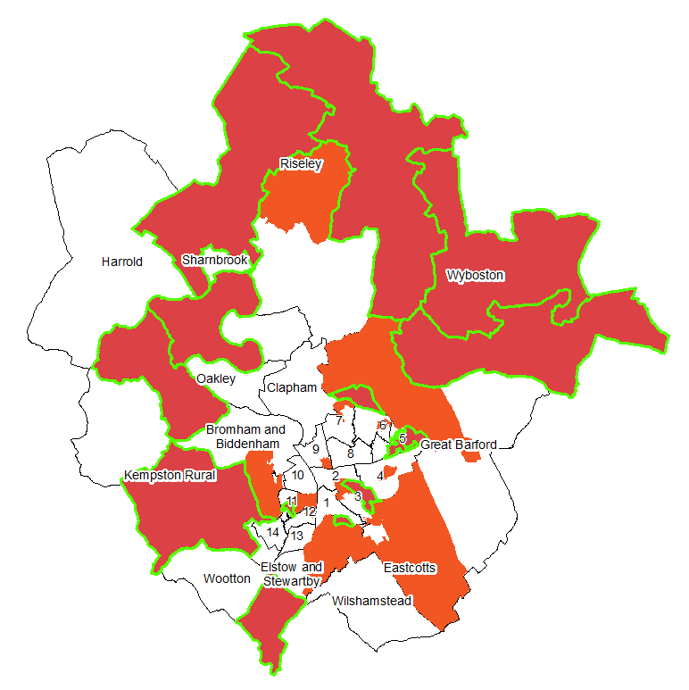
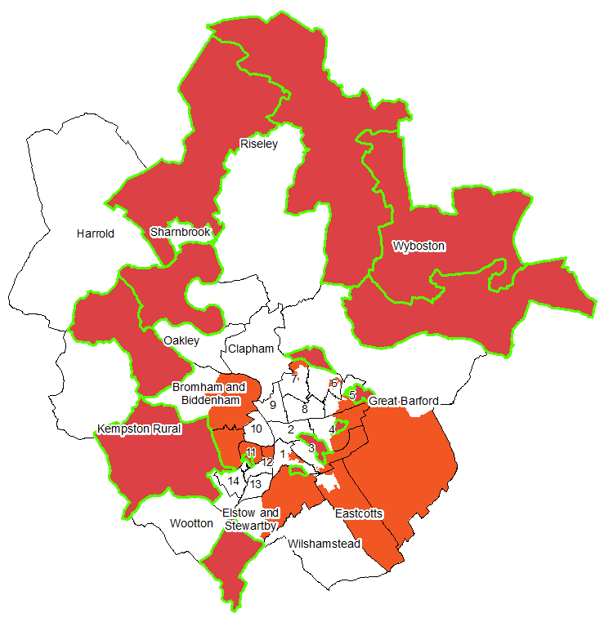
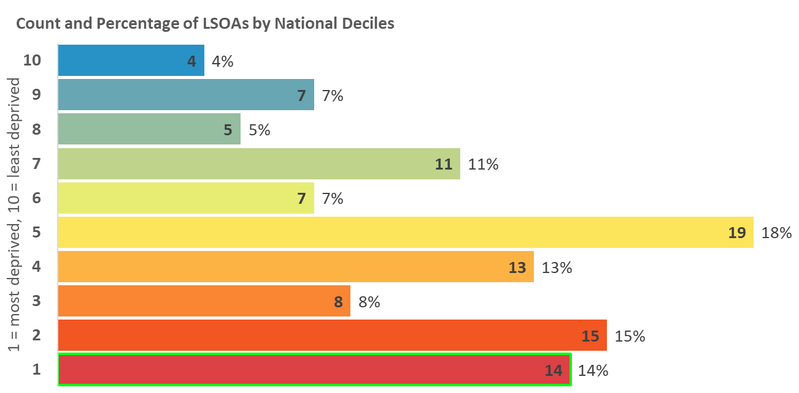
Indices of Deprivation 2019
Bedford Borough
Barriers to Housing and
Services Deprivation
Measures the physical and financial accessibility of housing and key local services. The indicators falls into two sub-domains: ‘geographical barriers’, which relate to the physical proximity of local services, and ‘wider barriers’ which includes issues relating to access to housing i.e. affordability.
Map 11: Distribution of Barriers to Housing and Services
Deprivation 2019
LSOAs amongst the most deprived 10% and 20% in England
2015
2019
Legend
10% most deprived
20% most deprived

Slide 15
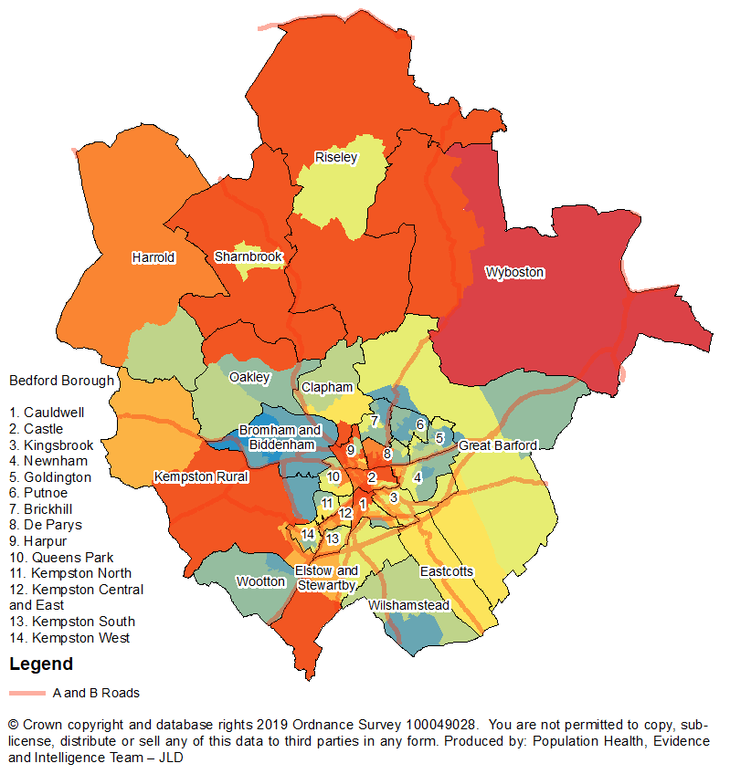
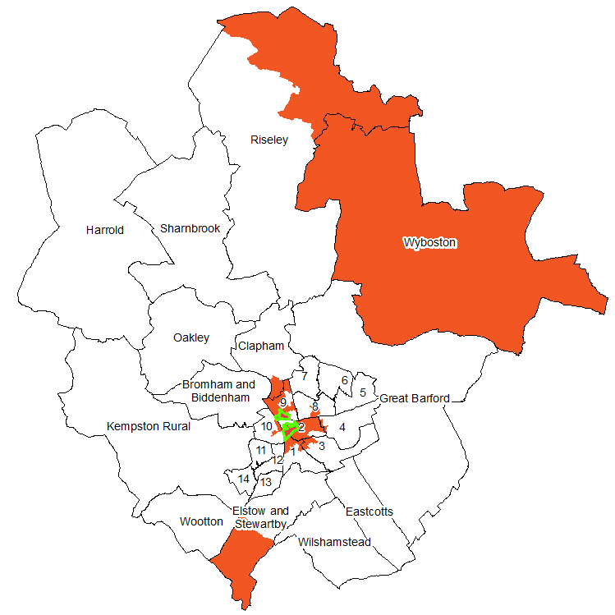
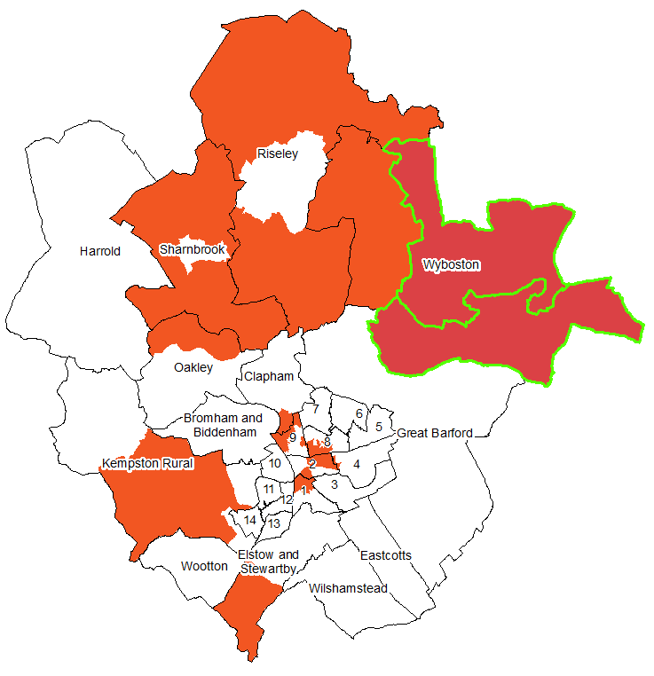
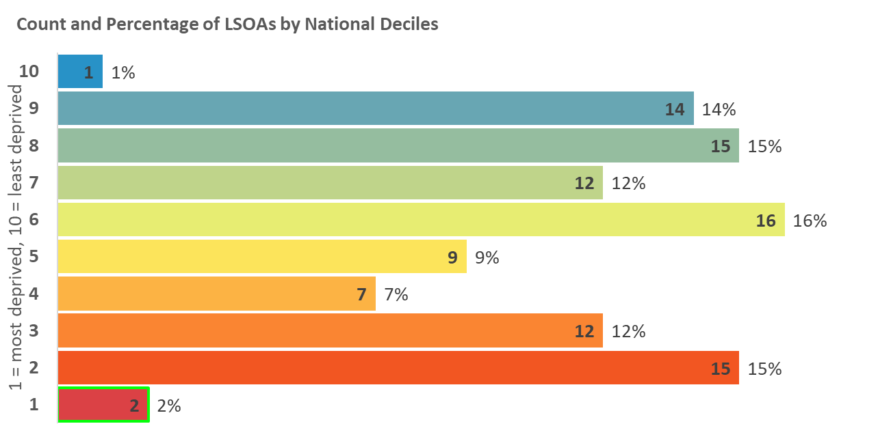
Indices of Deprivation 2019
Bedford Borough
Living Environment Deprivation
Measures the quality of the local environment. The indicator falls into two sub-domains. The ‘indoors’ living environment measures the quality of housing; while the ‘outdoors’ living environment contains measures of air quality and road traffic accidents.
Map 12: Distribution of Living Environment Deprivation 2019
LSOAs amongst the most deprived 10% and 20% in England
2015
2019
Legend
10% most deprived
20% most deprived

Slide 16
Indices of Deprivation 2019
Bedford Borough
Figure 2: Location by ward of the top 5 most deprived LSOAs
Ward | Overall | Income | Employment | Income deprivation affecting older people | Income deprivation affecting children | Education skills and training | Children and young people | Crime | Barriers to housing and services | Living environment | Adult skills | Health Deprivation and Disability
Brickhill
Bromham and Biddenham
Castle | ü | ü | ü | ü | ü |  |  | ü |  |  | ü | ü
Cauldwell | ü | ü | ü | ü | ü | ü |  |  |  |  | ü | ü
Clapham
De Parys |  |  |  |  |  |  |  |  |  |  |  | ü
Eastcotts
Elstow and Stewartby |  |  |  |  |  |  |  |  | ü | ü
Goldington |  |  | ü |  |  | ü | ü
Great Barford |  |  |  |  |  |  |  |  | ü
Harpur | ü | ü | ü | ü |  |  | ü | ü |  | ü |  | ü
Harrold |  |  |  |  |  |  |  | ü | ü
Kempston Central and East
Kempston North |  |  | ü |  | ü | ü
Kempston Rural
Kempston South
Kempston West
Kingsbrook |  | ü |  | ü |  |  |  |  |  |  | ü
Newnham
Oakley |  |  |  |  |  |  |  |  | ü
Putnoe |  |  |  |  | ü |  | ü
Queens Park |  |  |  |  |  | ü |  |  |  |  | ü
Riseley |  |  |  |  |  |  |  |  | ü | ü
Sharnbrook |  |  |  |  |  |  |  |  | ü
Wilshamstead
Wootton
Wyboston |  |  |  |  |  |  |  |  | ü | ü

Slide 17
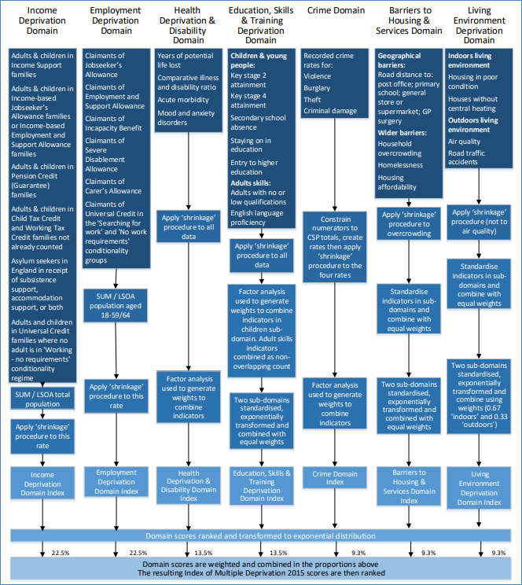
Indices of Deprivation 2019
Bedford Borough
Figure 3: Summary of the domains, indicators and statistical methods used to create the Indices of Deprivation 2019

Slide 18
Indices of Deprivation 2019
Bedford Borough
Further information
The full IoD data along with technical details and national reports can be found here:
https://www.gov.uk/government/statistics/english-indices-of-deprivation-2019
A helpful visualisation tool of the national results can be found here:
http://dclgapps.communities.gov.uk/imd/iod_index.html
The English IoD are published by the Ministry of Housing, Communities & Local Government.

