Slide 1
Bedford Borough JSNA
Children & Young People – update
17/01/2024
Public Health Intelligence and Evidence Team

Slide 2
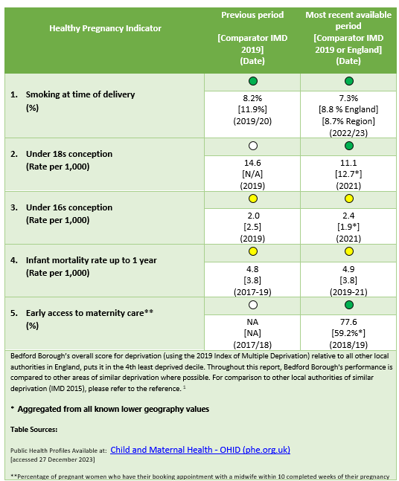
Bedford Borough Healthy Pregnancy

Slide 3
Bedford Borough Healthy Pregnancy Snapshot (2023)
Risk factor indicators
Health outcome indicators
Smoking is the biggest single factor that negatively impacts health in pregnancy. Fewer women in Bedford Borough are known to be smoking at the time of delivery than the average for the deprivation decile.
Infant mortality rate is higher in Bedford compared to the deprivation decile (and has increased slightly), but this difference is not statistically significant.
Teenage parenting increases the risk of poorer health outcomes without additional support. The rate of teenage pregnancy is slightly lower in Bedford Borough than the national average.
Fewer than 80 births per 1,000 are premature, below the average of similar local authorities based on deprivation.
Early access to maternity services improves birth outcomes. Over 3/4 of pregnant women accessed maternity care early in Bedford - significantly better than local authorities of similar deprivation.
The percentage of babies with a low birth weight in Bedford is in line with the average for England, but with significant variations, with Elstow and Stewartby much worse and Harold much better.
Obesity during pregnancy increases the health risks for both the mother and child. Over 1/2 of female adults in Bedford Borough are classified as overweight or obese.
About 1 in 5 women nationally are affected by perinatal mental health issues.

Slide 4
Healthy Pregnancy Priorities
Priority areas
Promote early access to maternity care.
Embed a ‘whole family’ approach.
Co-produce local maternity services.
COVID-19 recovery
Development of Community Maternity Hubs
Antenatal and postnatal care
Continuity of care
Priority actions
Roll-out ‘Continuity of Carer’.
Women and partners are listened to and heard.
Improved information sharing between maternity and health visiting services.
Efficient mental health referral system.
Monitor smoking in pregnancy.
Keeping Well in Pregnancy team.
Review Maternity Obesity Pathway.

Slide 5
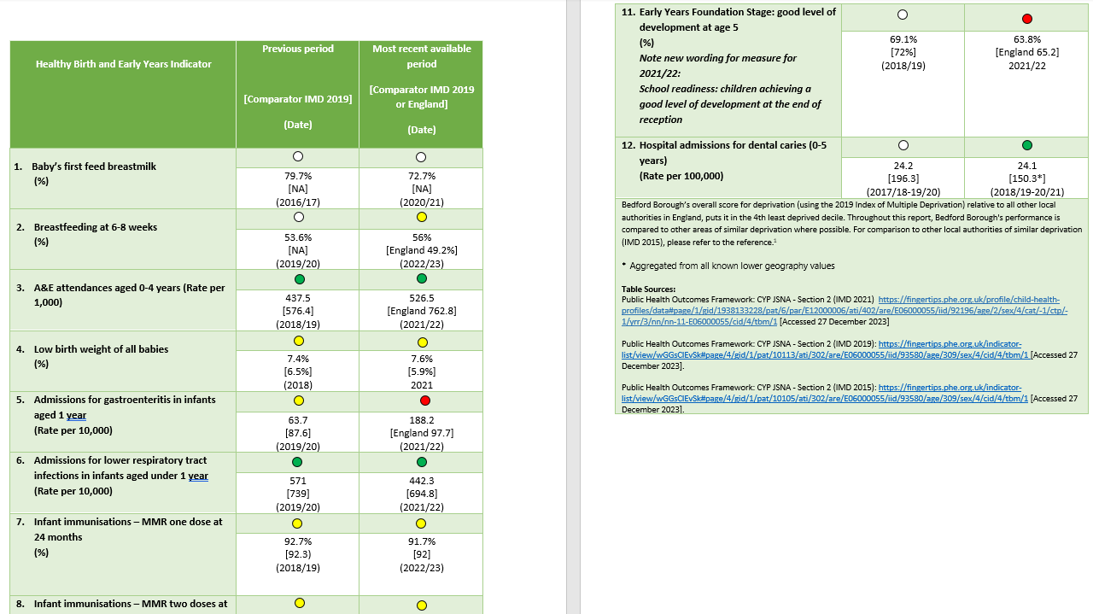
Bedford Borough Healthy Birth and Early Years

Slide 6
Bedford Borough Healthy Birth and Early Years Snapshot (2023)
Risk factor indicators
Health outcome indicators
Breast feeding is linked to lower the rates of gastroenteritis, respiratory infections, sudden infant death syndrome, obesity and allergies. The proportion of women breastfeeding at initiation is slightly down from previous years but at 6-8 weeks has improved. These are both significantly better than the national average.
The rate of A&E attendances in children aged 0-4 years has increased from the previous year but remains significantly lower than local authorities in the same deprivation decile.
Vaccination is recognised as one of the most effective public health interventions in the world. The percentage of infants who received two doses of MMR vaccine has increased from previous levels and is better than the national average.
The rate of admissions for lower respiratory tract infections in infants under the age of 1 year has decreased and is significantly better than local authorities in the same deprivation decile.
Admissions for gastroenteritis in 1-year-olds increased dramatically and is now significantly higher than local authorities in the same deprivation decile.
Poor oral health can affect a child’s ability to speak, eat, sleep, play, socialise, and can negatively impact on their school attendance and wellbeing. Over 1/5 of 5-year-olds exhibit visually obvious tooth decay. This is improving and is better than the national average.
The proportion of 5 year olds reaching a good level of development at the Early Years Foundation stage decreased slightly and is worse than local authorities in the same deprivation decile.
Adverse Childhood Experiences or traumatic events, such as domestic abuse increase the risk of high-risk behaviours and poorer outcomes as adults. The rate of domestic abuse incidents per 1,000 slightly reduced and is in line with the national average.

Slide 7
Healthy Birth and Early Years Priorities
Priority areas
Develop and retain integrated workforce.
Train all professionals working with children and families.
Support parents and carers in preparation for education.
Promote responsive breastfeeding, responsive bottle-feeding and smoke-free environments.
Reduce unintentional injuries.
COVID-19 recovery
0-5 services continuing to re-engage families as well as support healthy births and child development.
Face to face delivery of services alongside virtual support where proven effective.
Workforce recruitment remains challenging.
Priority actions
Vaccination delivery and monitor activity.
Improve immunisation rates through communication, co-ordination improvements and promotion.
Support access to community vaccination venues.
Improve response for vulnerable children.

Slide 8
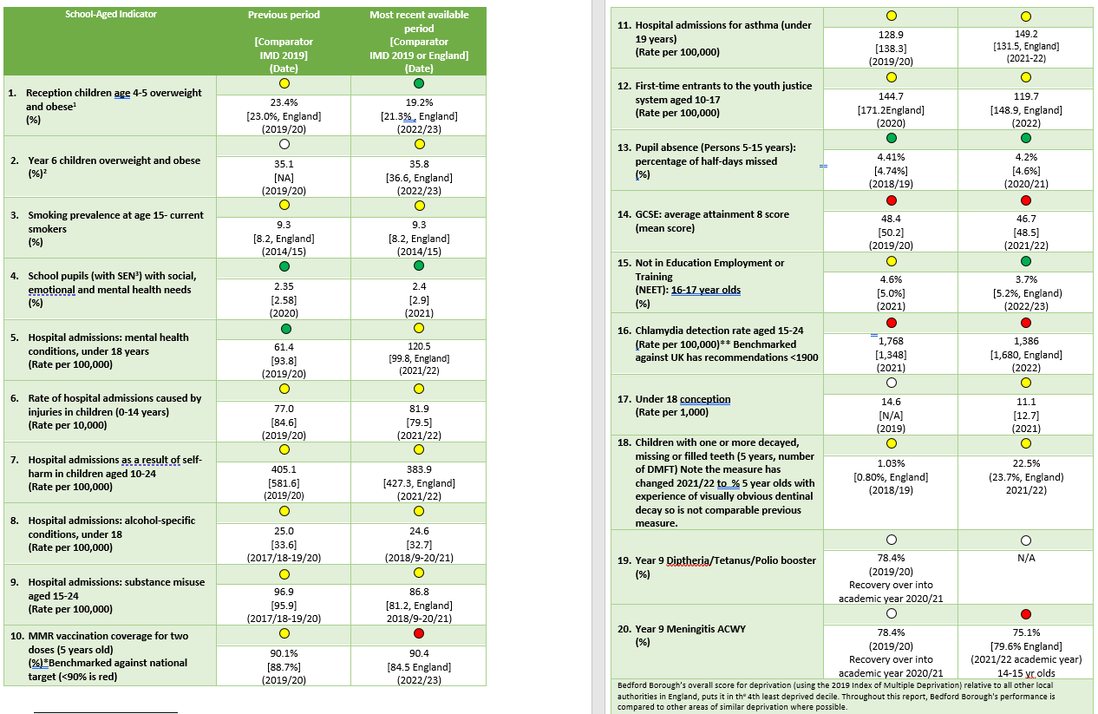
Bedford Borough School-aged Years

Slide 9
Bedford Borough School-aged Years Snapshot (2023)
Risk factor indicators
Outcome indicators
Obese children have a higher risk of poor health, disability and premature mortality in adulthood and potentially poorer teenage mental health. Roughly 1 in 5 Reception children are overweight or obese, this has improved and is significantly better than the national average. At Year 6 that proportion stays in line with the national average, which increased to around 36%.
Compared to local authorities in the same deprivation decile and/or national average, hospital admissions due to:
Self-harm in young people aged 10 to 24 years reduced and remains better.
Mental health conditions for those aged 0 to 17 increased Alcohol-specific conditions for those under 18 decreased and remains better.
Substance misuse for those aged 15 to 24 decreased
Unintentional and deliberate injuries in those under 14, increased slightly
Asthma for those under 18 increased and is now worse.
Children suffering from poor mental ill health are at risk of poor physical health outcomes, poor educational attainment, and are at greater risk of unhealthy behaviours. A lower number of school pupils in Bedford Borough have social, emotional and mental health needs than the average for the deprivation decile.
Smoking is a major cause of ill health, particularly heart and lung disease and many people who start smoking as adolescents continue to smoke into adulthood. The prevalence of smokers in Bedford Borough’s children under the age of 15 is above the national average.
The average Attainment 8 score at 15-16 years old continued to decrease and remains significantly worse than the deprivation decile average.

Slide 10
School-aged Years Priorities
Priority areas
Support education settings to provide information and curriculum in regards to good health, wellbeing and resilience.
Access to services that develop healthy behaviours.
Strengthen support regarding mental health.
Create communities with environment focus.
Effective contraception and sexual health services.
Safe at home and in community services.
COVID-19 recovery
Services changing the response to different needs and additional demands.
Commissioners and services to work more closely together to ensure effective early support.
Priority actions
Effectively communicate details of all services available.
Effectively address excess weight.
Act on the voice and experience of all young people.
Response to impact of adverse experiences, trauma and contextual safeguarding.

